Slide 1

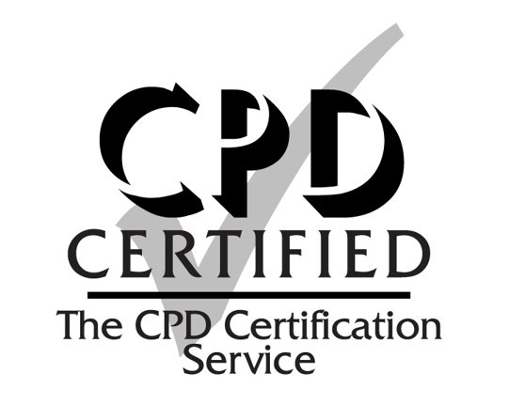
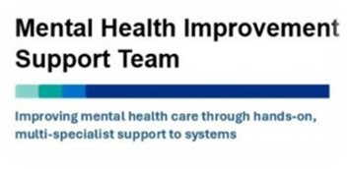
Interface Improvement Collaborative
Workbook 1 – Understanding the problem
`
`

Slide 2

Contents
What is a break-through series collaborative? | 3
Benefits of the interface improvement collaborative | 4
Understanding the problem: checklist | 5
Creating a SMART aim | 6
Developing your project aim | 7
Project charter | 8
Relationship building | 9
Stakeholder mapping | 10-11
Tools: 5Ps, process mapping, active listening and observations | 12-16
Measurement | 17-18
Reflecting on Biases | 19
Gibbs reflective cycle | 20
Demings's system of profound knowledge | 21
Making time for improvement projects | 22
Recommended reading | 23
Further Resources | 24

Slide 3
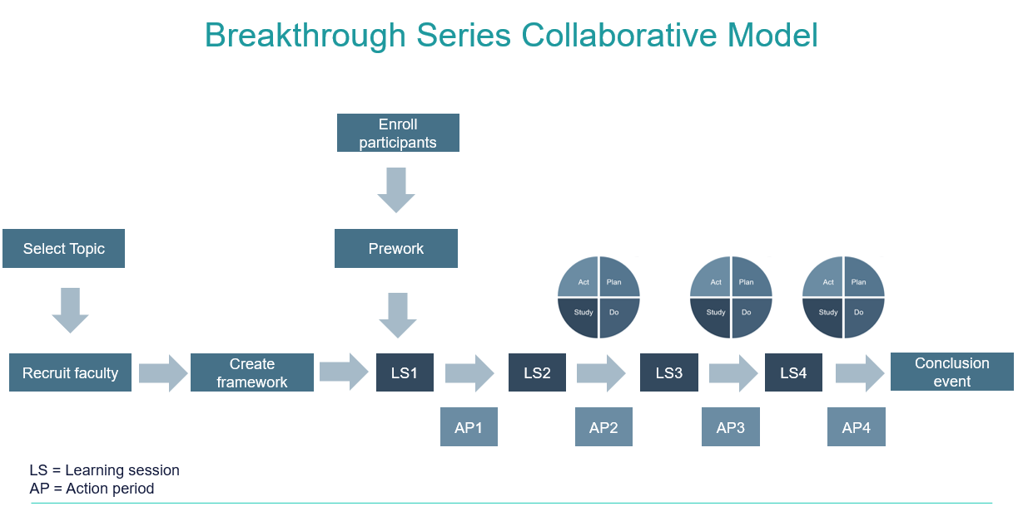
What is a breakthrough series collaborative?
A simple structured way to carry out improvement
Designed for large scale testing across multiple areas
Based on Institute for Healthcare Improvement (IHI)
It usually lasts between 6-15 months
It has a clear start and end point from problem to solution
It provides staff with basic tools and training
It provides a framework to apply learning in practice
There are a series of learning sessions over a period with structured improvement methodology and peering learning in them. In between each learning session, are action periods where participants are expected to apply their learning in practice and share progress at the following learning session

Slide 4
What are the benefits of the interface improvement collaborative?
Benefits to you
Learning improvement methodology and systems thinking
Transferring learning into practice through action periods
Developing links, connections and peer learning with others
Being part of a community tackling similar issues
Working with others to improve services to patients
Benefits to your team
Building relationships with team members across the interface
Working together on a specific problem to create positive change
Understanding the power of communication, teamwork and culture
Sharing learning, creating understanding and strengthening partnerships
Working together to improve services to patients
Benefits to patients
Working together as a team to improve patient experience across the interface
Improving accessibility, communication with patients and continuity of care
Some of your improvements will help reduce time wasted by patients
Their care is provided and completed in the right person by the right profession

Slide 5

Understanding the problem: checklist
When scoping the problem has the following been done?
Does everyone understand WHY this problem is being addressed?
Have you spent enough time understanding the problem?
Have you engaged with different people to scope out problem?
Have you identified and agreed your outcome measures?
Is everyone clear on the scope/parameters/boundaries of the project?
Have you mapped out all the key stakeholders to involve?
Do you have a plan on how to keep connected as a project team?
Is there a consensus on expected behaviours and personal approaches?
Do you have a SMART aim which describes the problem and desired output?
Is there a common agreed understanding of the problem across the interface?
Do you have access to a 6-month benchmarking period of outcome data?
UNDERSTANDING THE PROBLEM

Slide 6
Creating a SMART aim
This helps to clearly define your problem plan
S
SPECIFIC: Clearly define what it is trying to achieve, by when and how this will take place. The idea is if someone “external” reads it, they would understand what you are trying to achieve and why. No unclear language should be used, no solutions should be included. Your aim should be around 2-3 sentences
M
MEASURE: Aim statement needs to include an outcome measure to understand if the aim has been achieved at the end of the project. It needs to be numerical, linked to what you want to achieve as the output and ideally include how much you want to improve by e.g. a %
A
ACHIEVABLE: Improvement should push you, but it is important that they are achievable, manageable and relevant. They should be within the scope of the service/teams/organisation’s ability to carry it out. Don’t attempt to do too much at once
CREATING A SMART AIM
R
REALISTIC: The time frame by which you want to achieve it and what you want to achieve should be realistic. It must be reasonable enough to accomplish but not below expected standards, given the resources available (people/time/support) and it needs to be something you can influence
T
TIME: The time period for the improvement needs to be clearly stated so there is an end date. (Day/Month/Year). This helps with creating a sense of urgency and better time management. If it is a very complex problem, you can start by thinking about the first stage you want to complete
Example of an Aim statement:
To reduce the total number of inappropriate outpatient referrals sent by primary care “X” that are rejected by secondary care in “X” (list locations/organizations). This will be for “X” specialties, and we aim to reduce them by 10% by 1st January 2025. The intended benefit is to help reduce time wasted by services, improve patient care/experience by providing right care first time and help reduce unnecessary delays for patients seeking care

Slide 7
Developing your project aim
Overall problem/area issue:
Your purpose in wanting to improve this (WHY):
Your proposed SMART aim statement:
What further scoping or tools will you use to understand the problem further:
What scale are you operating at within the system? (mico, meso or macro) and list the areas involved in your project
AIM STATEMENT PLANNING

Slide 8
Project Charter
A simple one pager to help define your project
Problem Statement (what is the current problem & why does it need to be improved?) |  | Outcomes (what do you intend to achieve from this project, what are the outcomes? What will it improve? How will things be better? Evidence your outcomes
In Scope (what will be covered by the project) | Out of Scope (what will not be covered by the project)
Quality Impact (How will the project improve patient: experience, safety, outcomes, care, services or reduce risk/harm to patients?) |  | Measurements (What data both qualitative and quantitative can you collect to show an improvement has been made? )
 |  | Description of Measure | Baselines (what are they currently at prior to the project?) | Target (Where do you want them to be?)
Team (Who is your project team involved in the project?) |  | What are your key milestones
PROJECT CHARTER

Slide 9
Relationship building
How will you keep connected and learn from others?
Communication methods How will you talk to each other – on what format? Teams? Emails? WhatsApp? |  | Understanding How will you create an understanding of each other’s roles, experiences and views? Meetings? Shadowing? Observe?
Listening How will you make the space and time to truly listen to each other to understand? Coffee chat? Off-site meet? Protected time? |  | Challenge your biases How will you reflect on your own thoughts and assumptions? Reflective journal? Speak to a mentor?
Personal connections How will you make personal connections, build trust and connect? Talk about personal interests? Life outside of work? What matters to you? |  | What else? What other ideas do you have on how you can build good engagement with other team members across the interface?
BUILDING RELATIONSHIPS
Your chosen approaches on building relationships:

Slide 10
Stakeholder mapping
Keep satisfied
Manage closely
Low Influence/Power High Influence/Power
Patients
STAKEHOLDER MAPPING
Monitor
Keep informed
Low interest/impact High interest/impact
Map who is involved, responsible & impacted at every stage
Add names to the most relevant quadrant based on influence and the impact level they hold
Who are your most important stakeholders?
Are they likely to be drivers or resistors of your improvement?
Remember:
You cannot be everything to everyone
You cannot engage with everyone to the same degree
You need to think about different ways of engaging with people
Put your efforts towards the most influential/interested stakeholders

Slide 11
Stakeholder mapping
High Power | Satisfied People who have a high power of influence over the project, but they just need to be kept satisfied with what is happening | Manage People who have a high power of influence over the project who should be fully engaged through communication and consultation
Low Power | Monitor People who have low power that could be ignored if time and resources are stretched | Inform People who have a low level of influence, but it is helpful to keep them informed
 | Low interest/impact | High interest/impact
Stakeholder Name | Job role details | Impact (High or low?) | Influence (High or low power?) | How could they contribute to the project? | How could they block the project?
STAKEHOLDER MAPPING

Slide 12

5Ps
This approach involves building the self-awareness of the team members working within a system.
It helps you develop an understanding of the systems, processes and patterns that connect them
The five Ps framework is used to describe the key components of the work of a microsystem and is used to guide investigations into areas of work, leading to the identification of improvement needs.
The five Ps are:
Purpose: a clear, agreed and shared understanding of the fundamental aim of the team’s work
People: the views, attitudes and experiences of the staff working within the microsystem
Patients: the characteristics, needs and views of the patients subject to the care of the microsystem
Processes: the routines and procedures for undertaking the work of the microsystem
Patterns: Data providing insight into the performance of the microsystem.
Purpose:
People:
Patients:
Processes:
Patterns:
5 PS – TOOL
Further reading: chrome-extension://efaidnbmnnnibpcajpcglclefindmkaj/https://www.sheffieldmca.org.uk/UserFiles/File/5Ps_One_Page_Book.pdf

Slide 13
Process Mapping the System
What is process mapping?
It provides a holistic overview of all the “cogs” working together in a system or process - this increases the chances of identifying significant improvement areas
Current steps in a pathway, service or process are mapped out on paper with post-it notes to understand it further
Each step is assessed to understand the value in the journey and why it is done – everyone questions the purpose
This allows you to analyze and redesign what the steps should be based on improvement opportunities
A process map allows you to see the bigger picture of all the processes joined together, which you can then use to identify problems & improvements
PROCESS MAPPING – TIPS
Top tips for process mapping:
Prework: Understand the basic steps in the pathway before mapping it
Data: Review key data that provides evidence e.g., capacity/waits
Diverse Group: Invite people from all the key touch points in a pathway
Intention: Be clear on the purpose (WHY) of mapping the pathway
Timings: Make sure you built in enough time to give the same level of attention to all the stages of the process map (not rushing at the end)
Post-it notes: Are used to allow steps to be moved around. Tape them down at the end when completed
“Park it” and “ideas” board: Things that require time & thinking can be noted and placed to the side – we can’t fix everything at once
Clear start and end point: Agree and define the scope of the mapping
Map high level points: Doing this first, sets the sequence of what needs to be mapped out in further detail underneath it
Transfer map: Once completed, the paper map needs transferring into a digital format e.g. powerpoint, word or software like Viso

Slide 14
Process Mapping the System
Questions to think about when process mapping:
Waste | Do we really need to do this step? Can it be done better?
Staff | Are they the right people to do the task? Could anyone else do it?
Benefits: | What is the value in doing this step?
Duplication: | Do we do it too often and why? Is there a simpler way?
Bottlenecks: | What are the steps that cause issues and problems to progress? What are the blockers?
Error correction: | How much extra do we do to rectify something that was not right before?
Demand: | Do we know how much requests/needs we get for certain steps, and can we manage them?
Capacity: | Are we using our resources in the right places and is there enough of it? How is it spread out?
Variation: | Are people doing things differently and why?
Experiences/ emotions: | How do staff or patients feel about some of the steps that occur?
Communication: | Does everyone understand what is needed and why?
PROCESS MAPPING – TIPS

Slide 15
HANDOUT
Active Listening
3 LEVELS OF LISTENING
LEVEL ONE
Internal: Focus on your own thoughts and inner voice. You are listening with the intent to respond – not to understand
LEVEL TWO
External: Listening intently to others. You are fully present and focused on them. You are curious about them. This is when people begin to feel seen and heard
LEVEL THREE
Global/wider: Extend focus beyond the conversation to your surroundings as well. You use all senses to feel the complete context
https://medium.com/swlh/strategic-leadership-the-3-levels-of-listening-e3f0c27f8d01
ACTIVE LISTENING
Practice
Have a conversation with someone where you need to do most of the listening. Ask them at the end of it if they’d feel comfortable in providing feedback on their perception of your listening. Choose someone who you know is comfortable in providing honest feedback
Did you feel like I was fully committed to listening to you?
Did I show any behaviors that suggested I wasn’t listening?
How did you feel talking to me? Did you feel heard and seen?
Is there anything I can do better to be fully engaged with you?
Did I show a good understanding on what you were talking about?
Did you notice anything about my facial expression, body language or tone?

Slide 16
HANDOUT
Observations
3 TYPES OF OBSERVATION
SILENT
Useful when collecting raw data and typically takes only a couple of minutes to an hour
INTERACTIVE
Requires the observer to visit the actual place to observe the process, ask questions, and learn
EXTENDED
The observation period takes much longer time to thoroughly understand the current state of a process
https://citoolkit.com/articles/observation/
The 3 basic rules of Gemba walk
Gemba means “the place where value is created” in Japanese. Its initial purpose is to observe the actual work process, engage with others, gain knowledge about the work and explore opportunities for improvement.
Step 1: Go see: You have to go see with your own eyes how the connections and different processes work
Step 2: Ask why: You have to understand each step of the process in detail in order to understand the problems. Many tasks are done routinely without the staff wondering if they are right or wrong. Asking why will help you understand how to improve processes.
Step 3: Show respect: You should show others that you care for their well-being. Make sure to involve them and let them know that gemba walks are taking place. You are not there to judge, share your opinion or criticize.
Write down everything that is of importance or record it with your phone
OBSERVATIONS

Slide 17
Examples of data sources
There is a wealth of data that already exists
Safety incidents | Patient survey results | Clinical audits
Complaints | Staff survey | Patient feedback
Waiting times | Observations | Interviews
Targets | Performance statistics | Create your own tally!
Activity levels | Characteristic factors | Financial
Operational service data | Harm rates | What else?
IDENTIFYING DATA

Slide 18
Measurement Template
Being clear on who will collect what, when and how
Measure Definition What is the data you want to collect – define it | Type of measure Outcome Process Balancing Which one is it? | Concept Why Measure it? | Frequency How often will it be collected? Will it be all occurrences, a sample or snapshot? | Data Collection How will the data be collected? Is there a system? Will it be done manually? | Person Who will be the person responsible for collecting it?
MEASUREMENT TEMPLATE

Slide 19
Reflecting on Biases
Which ones do you witness? Which ones do you have?
Authority Bias The tendency to attribute greater accuracy to the opinion of an authority figure and be more influenced by that opinion | Bandwagon effect The tendency to do (or believe) things because many other people do (or believe) the same. | Confirmation Bias The tendency to search for, interpret, focus on and remember information in a way that confirms one's preconceptions.
Empathy Gap The tendency to underestimate the influence or strength of feelings, in either oneself or others. | Focusing Effect The tendency to place too much emphasis on one aspect of an event. | Illusory Correlation Inaccurately perceiving a relationship between two unrelated events.
Mere Exposure Effect The tendency to express undue liking for things merely because of familiarity with them | IKEA Effect Place a disproportionately high value on objects that they partially assembled themselves - regardless of end quality | Social Comparison Bias The tendency, when making decisions, to favour people who don't compete with one's own particular strengths.
REFLECTING ON BIASES
Which ones do I witness?
Which ones do I display?
How will I recognize or challenge them?

Slide 20
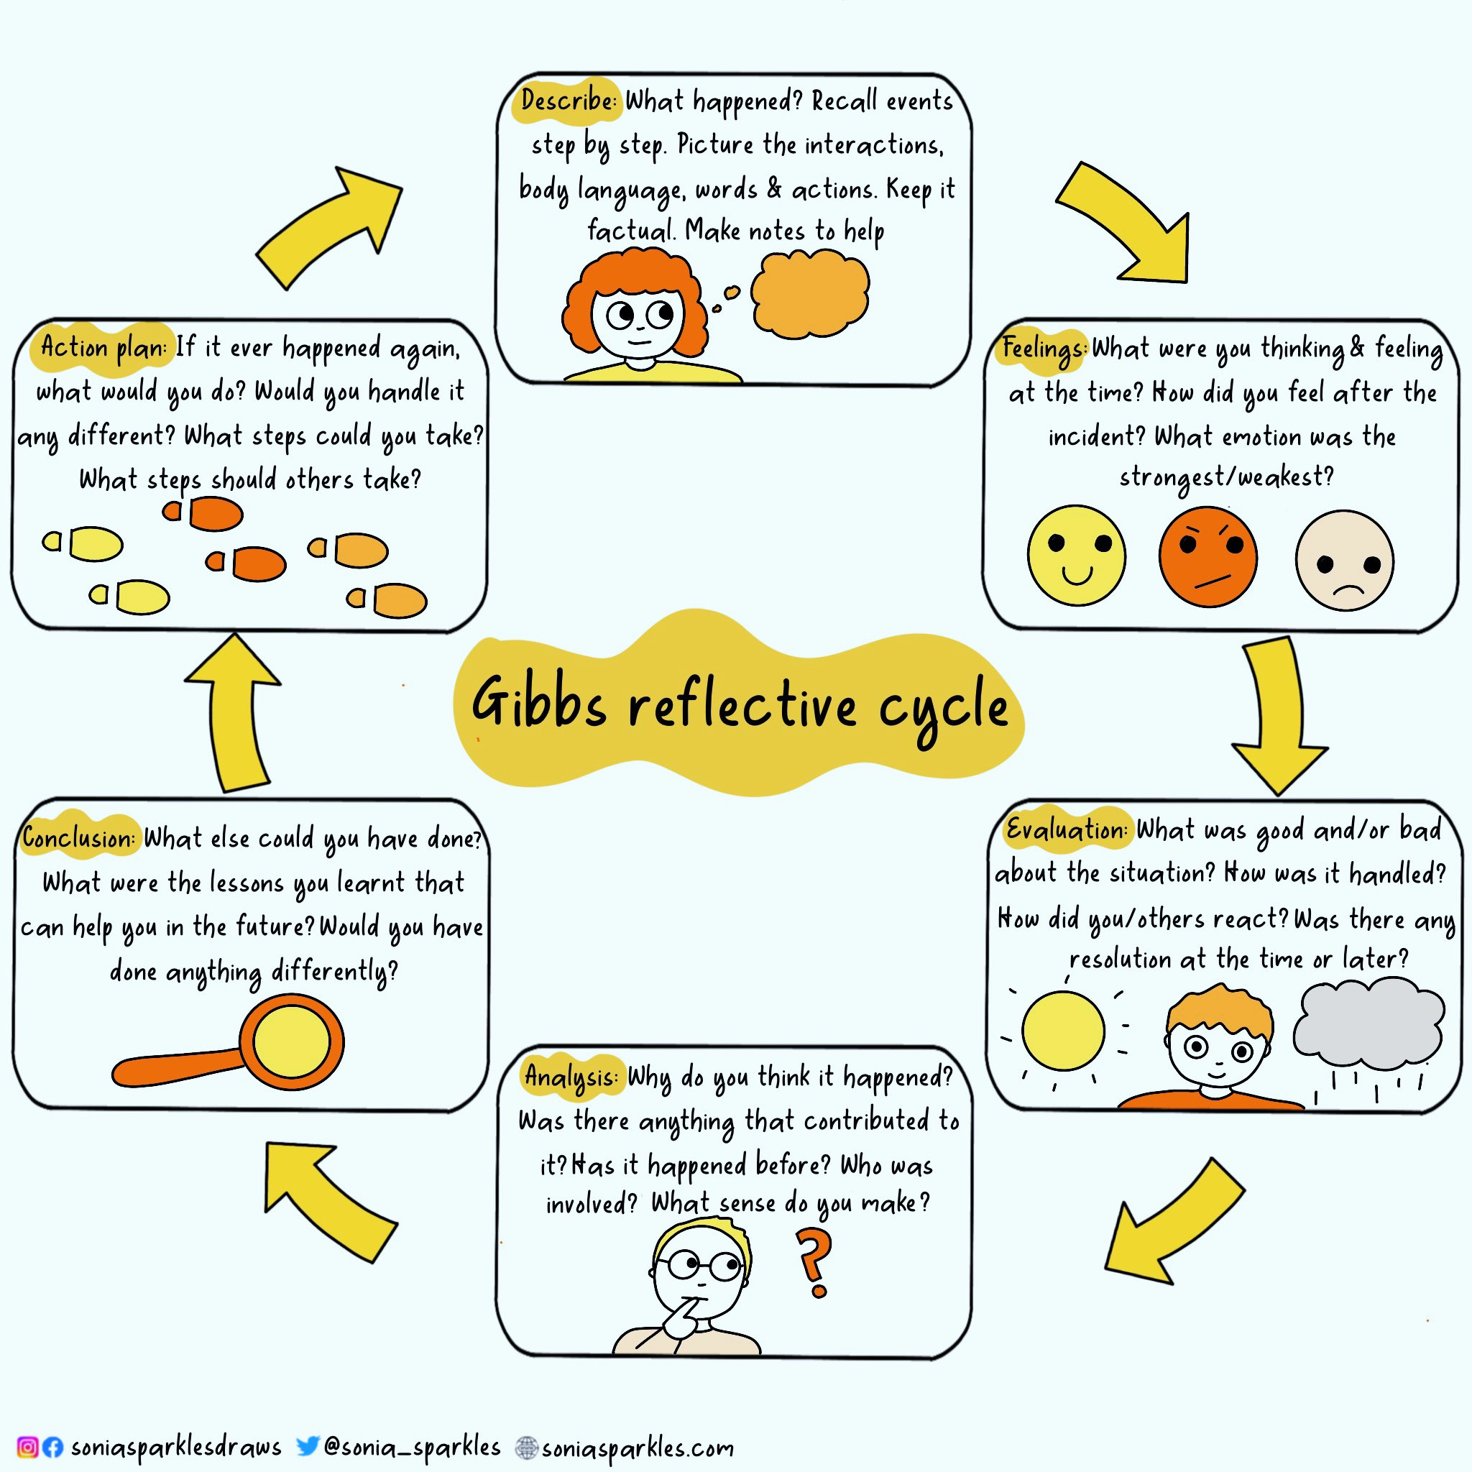
Reflective Learning
How will you reflect on your journey?
GIBBS REFLECTIVE CYCLE
Reflection is often overlooked as we rush to do the next thing in the improvement journey. How will you ensure you reflect on your learning, your actions throughout your improvement project and interaction with others?
Use Gibbs reflective cycle to make notes on significant events
Use it is a framework to think back over what happened and what you might do differently
Use it to understand different perspectives and the full situation

Slide 21
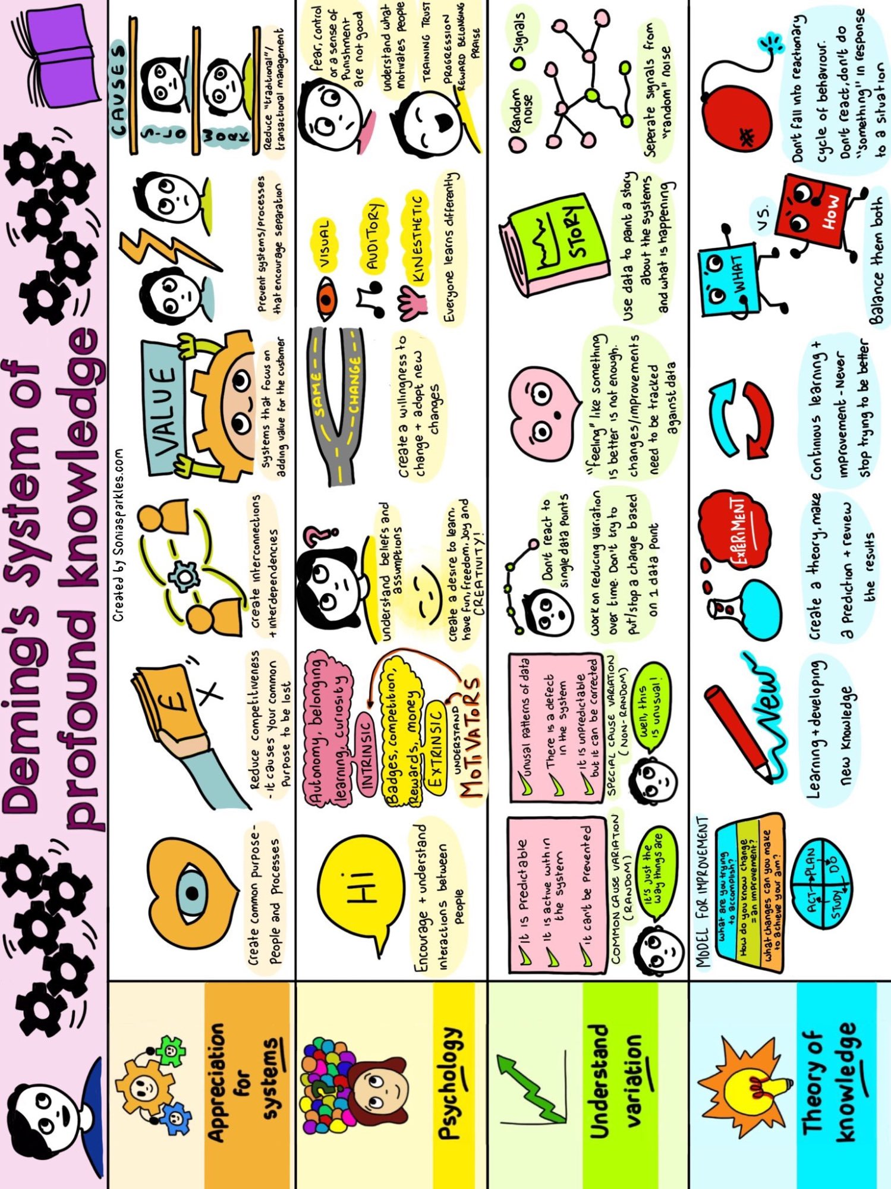
DEMINGS SYSTEM OF PROFOUND KNOWLEDGE – OVERVIEW

Slide 22
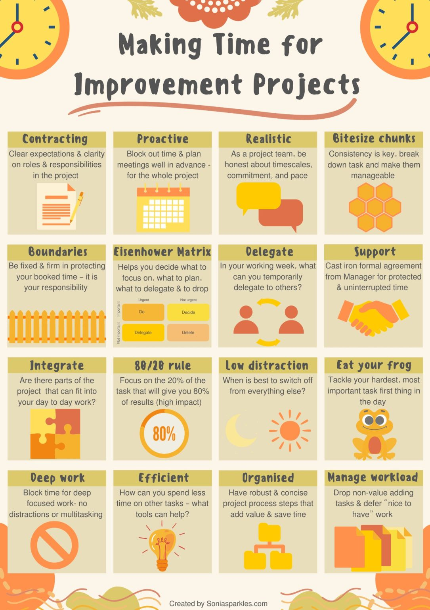
MAKING TIME FOR IMPROVEMENT PROJECTS – SOME HINTS AND TIPS

Slide 23
Recommended Reading
Books:
Start with Why – Simon Sinek
Dare to Lead – Brene Brown
Team of Teams: New Rules of Engagement for a Complex World – General Stanley McChrystal
7 Habits of highly effective people – Stephen R Covey
The Chimp Paradox – Prof Steve Peters
Leading Change – John Kotter
Leading in a culture of change – Michael Fullan
Compassionate Leadership – Michael West
The improvement guide – Gerald J Langley
Rebel ideas – Matthew Syed
Emotional intelligence – Daniel Goleman
Deming's Journey to Profound Knowledge – John Willis
TED Talks / Videos:
Systems Thinking is Not Optional: Lessons From a Pandemic - Steve Woodsmall
Front-to-back thinking - Hamish Dibley
The power of believing that you can improve - Carol Dweck
Changing Trends in Healthcare - Peter Nieminen
Why change is so scary — and how to unlock its potential -Maya Shankar
Data-Driven Solutions in Healthcare - Taimoor Shah
RECOMMENDED READING

Slide 24
Further Resources
NHS Improvement resources:
ILG-1.1-Improvement-Knowledge-and-Skills.pdf
ILG-3.4-Leading-Improvement.pdf
ILG-2.3-Improving-Flow.pdf
ILG-1.5-Evaluating-Improvement.pdf
ILG-3.3-Building-and-Nurturing-an-Improvement-Culture.pdf
https://www.england.nhs.uk/long-read/guidance-on-implementing-the-national-partnership-agreement-right-care-right-person/
NHS England » Guidance on implementing the National Partnership Agreement: Right Care, Right Person
NHS IMPACT (Improving Patient Care Together) - FutureNHS Collaboration Platform
Operational Flow - Mental Health in ED - FutureNHS Collaboration Platform - & Mental Health Action Cards (Final) Acute - Operational Flow - Mental Health in ED - FutureNHS Collaboration Platform
QSIR tools: https://www.england.nhs.uk/sustainableimprovement/qsir-programme/qsir-tools/
Royal College resources:
Mental_Health_Toolkit_April_2023_v1.pdf
Mental health information and resources
https://www.rcpsych.ac.uk/docs/default-source/members/faculties/liaison-psychiatry/liaison-sidebyside.pdf
News articles:
Mental health A&E programme ‘not far away’ | News | Health Service Journal
New NHSE incentive scheme ‘doesn’t make sense’, experts warn | News | Health Service Journal
‘Significant rise’ in children admitted to acute wards for mental health issues
Embedding a culture of quality improvement | The King's Fund
FURTHER RESOURCES

