Slide 1

Interface Improvement Collaborative
Workbook– Session 3: Human Factors and Behavioural Change
`
`

Slide 2

Contents
What is a break-through series collaborative? | 3
Benefits of the interface improvement collaborative | 4
Understanding human factors | 5
Our leadership way | 6 - 7
Compassionate leadership | 8 - 10
Psychological safety | 11
VUCA environments | 12
Leadership & delivering successful change | 13 - 15
Prioritising your ideas to test out | 16 - 17
Reflective log | 18
Gibbs reflective cycle | 19
Recommended Reading | 20

Slide 3
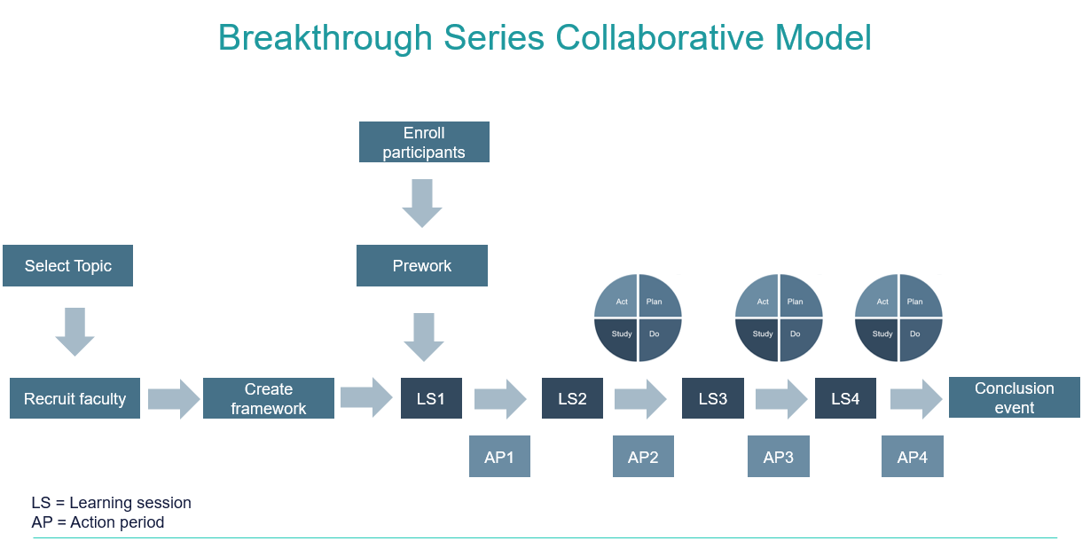
What is a breakthrough series collaborative?
A simple structured way to carry out improvement
Designed for large scale testing across multiple areas
Based on Institute for Healthcare Improvement (IHI)
It usually lasts between 6-15 months
It has a clear start and end point from problem to solution
It provides staff with basic tools and training
It provides a framework to apply learning in practice
There are a series of learning sessions over a period with structured improvement methodology and peering learning in them. In between each learning session, are action periods where participants are expected to apply their learning in practice and share progress at the following learning session

Slide 4
What are the benefits of the interface improvement collaborative?
Benefits to you
Learning improvement methodology and systems thinking
Transferring learning into practice through action periods
Developing links, connections and peer learning with others
Being part of a community tackling similar issues
Working with others to improve services to patients
Benefits to your team
Building relationships with team members across the interface
Working together on a specific problem to create positive change
Understanding the power of communication, teamwork and culture
Sharing learning, creating understanding and strengthening partnerships
Working together to improve services to patients
Benefits to patients
Working together as a team to improve patient experience across the interface
Improving accessibility, communication with patients and continuity of care
Some of your improvements will help reduce time wasted by patients
Their care is provided and completed in the right person by the right profession

Slide 5
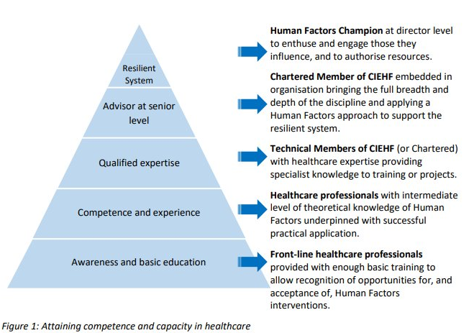
Understanding human factors
Human Factors works best when expertise is part of the whole system. This allows us to combine a focus on people’s needs with the process improvements used in Quality Improvement.
The CIEHF’s Human Factors in Health & Social Care White Paper has a tiered system for this level of understanding.
UNDERSTANDING HUMAN FACTORS

Slide 6
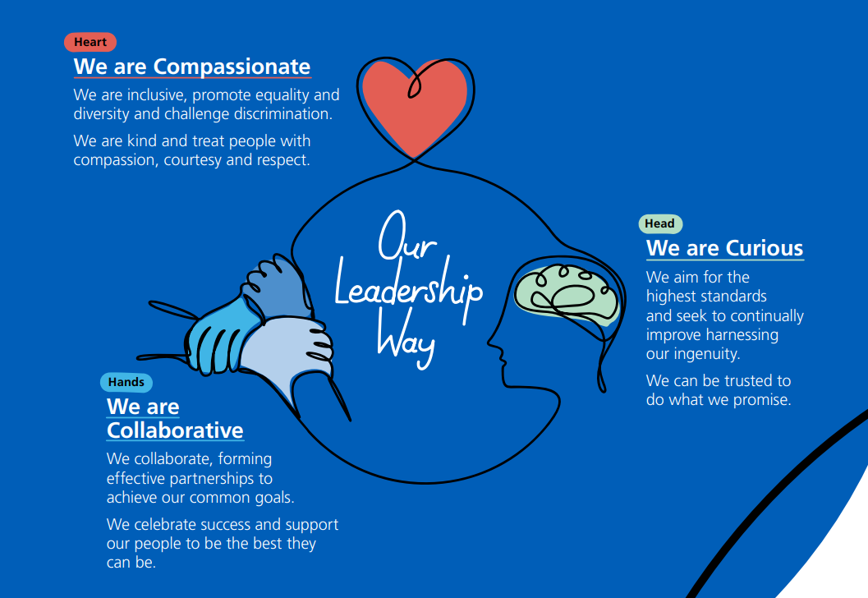
Our leadership way
Co-created with thousands of our NHS people, Our Leadership Way sets out the compassionate and inclusive behaviours we want all our leaders at every level to show towards us as individuals and our colleagues.
Complementing the NHS People Promise, Our Leadership Way formalises the approach our NHS leaders should take. Our Leadership Way sets out the compassionate and inclusive behaviours we want leaders at all levels to show towards us as individuals and our colleagues. It introduces how leaders at every level across the NHS can help raise the standards of leadership by committing to compassionate and inclusive leadership, supported by a culture of lifelong learning and development. It describes how we can operate at our best and is a tool for leaders to use to consider how their behaviour impacts on the cultures they create.
Why have Our Leadership Way?
Our Leadership Way is about promoting the right behaviours and signalling that leadership success is not just about what we deliver but how we deliver it. This is a tool for leaders to use to consider how their behaviour impacts on our NHS People Promise and the culture they aspire to create. Good leadership:
Enables individuals and teams to perform at their best
Makes people feel valued and
Provides better, safer more effective patient care.
OUR LEADERSHIP WAY

Slide 7

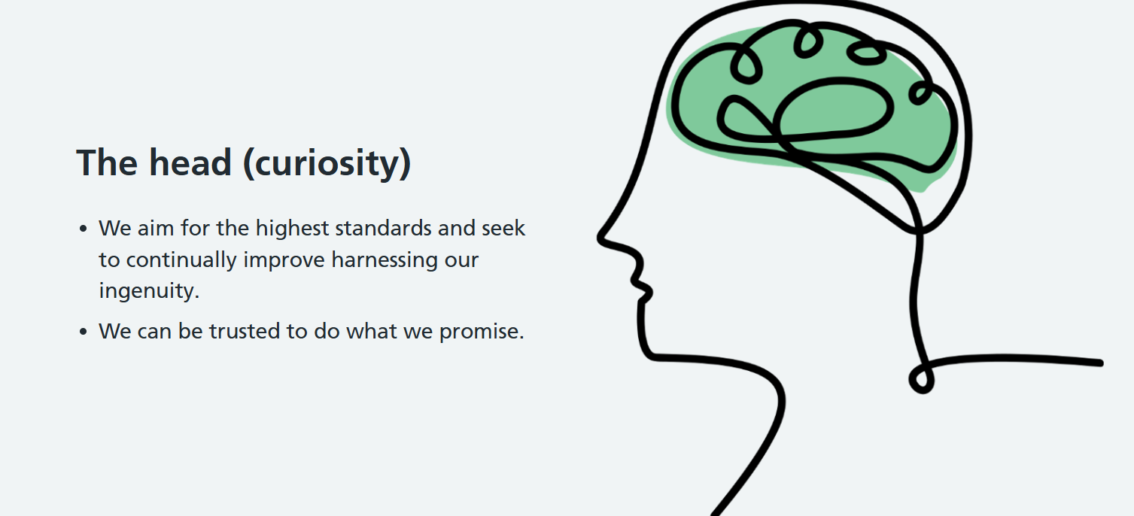
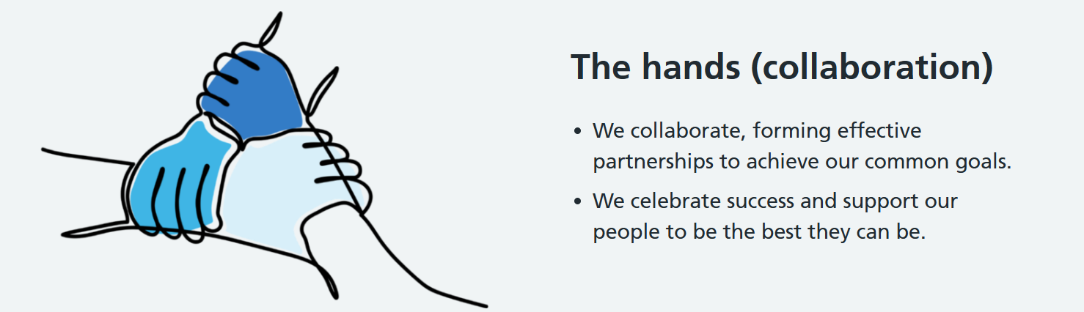
Our leadership way – 6 principles
OUR LEADERSHIP WAY
For more information please visit - Our Leadership Way – Leadership Academy

Slide 8
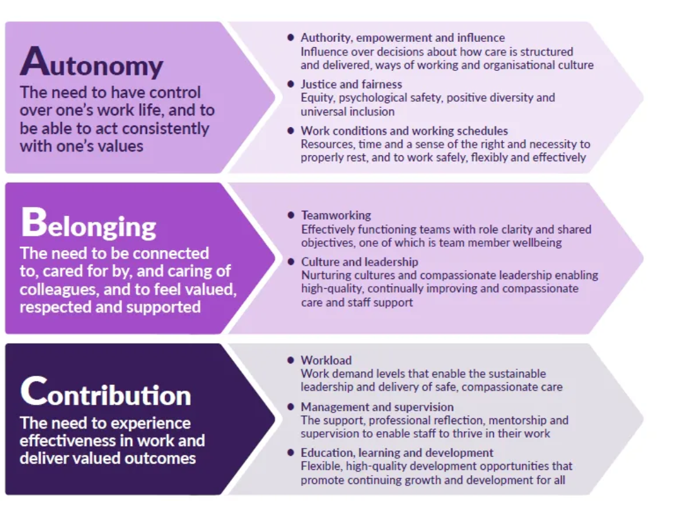
Compassionate Leadership
Leaders who model compassion, inclusion and a focus on improvement are key to creating cultures where diversity is valued, people feel they belong and are empowered to deliver great care and patient experience.
Continuous improvement depends on staff feeling safe and empowered to improve services using tried and tested improvement approaches in partnership with patients, families and communities. Where leaders act with compassion, staff feel valued, engaged and enabled to show compassion themselves. They feel obliged to speak up when something is wrong and empowered to continuously improve.
To ensure wellbeing and motivation at work, and to minimise workplace stress, research evidence suggests that people have three core needs – autonomy, belonging and contribution – and all three must be met for people to flourish and thrive at work. The initial research and review carried out by Dr Micharl West in Sept 2020 identified eight key areas where action is needed to ensure that these three core needs are met (see Figure 1, below).
COMPASSIONATE LEADERSHIP

Slide 9
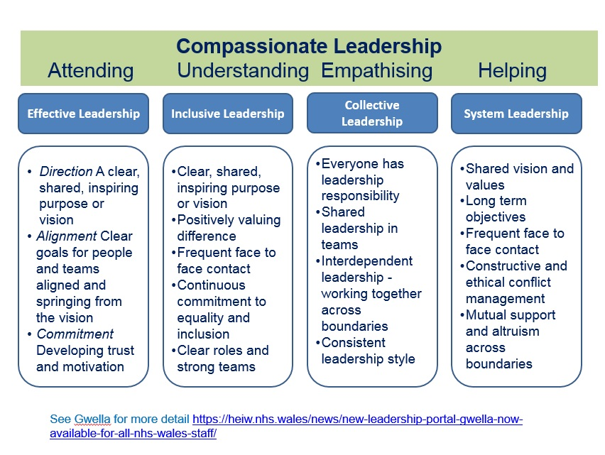
Compassionate Leadership in action
Dr Michael West’s work highlights the importance of compassionate leadership in creating positive work environments and improving outcomes, both for staff and patients.
In the context of ED and Mental Health, compassionate leadership can foster understanding and empathy between teams, even when there are challenges in patient care.
COMPASSIONATE LEADERSHIP

Slide 10
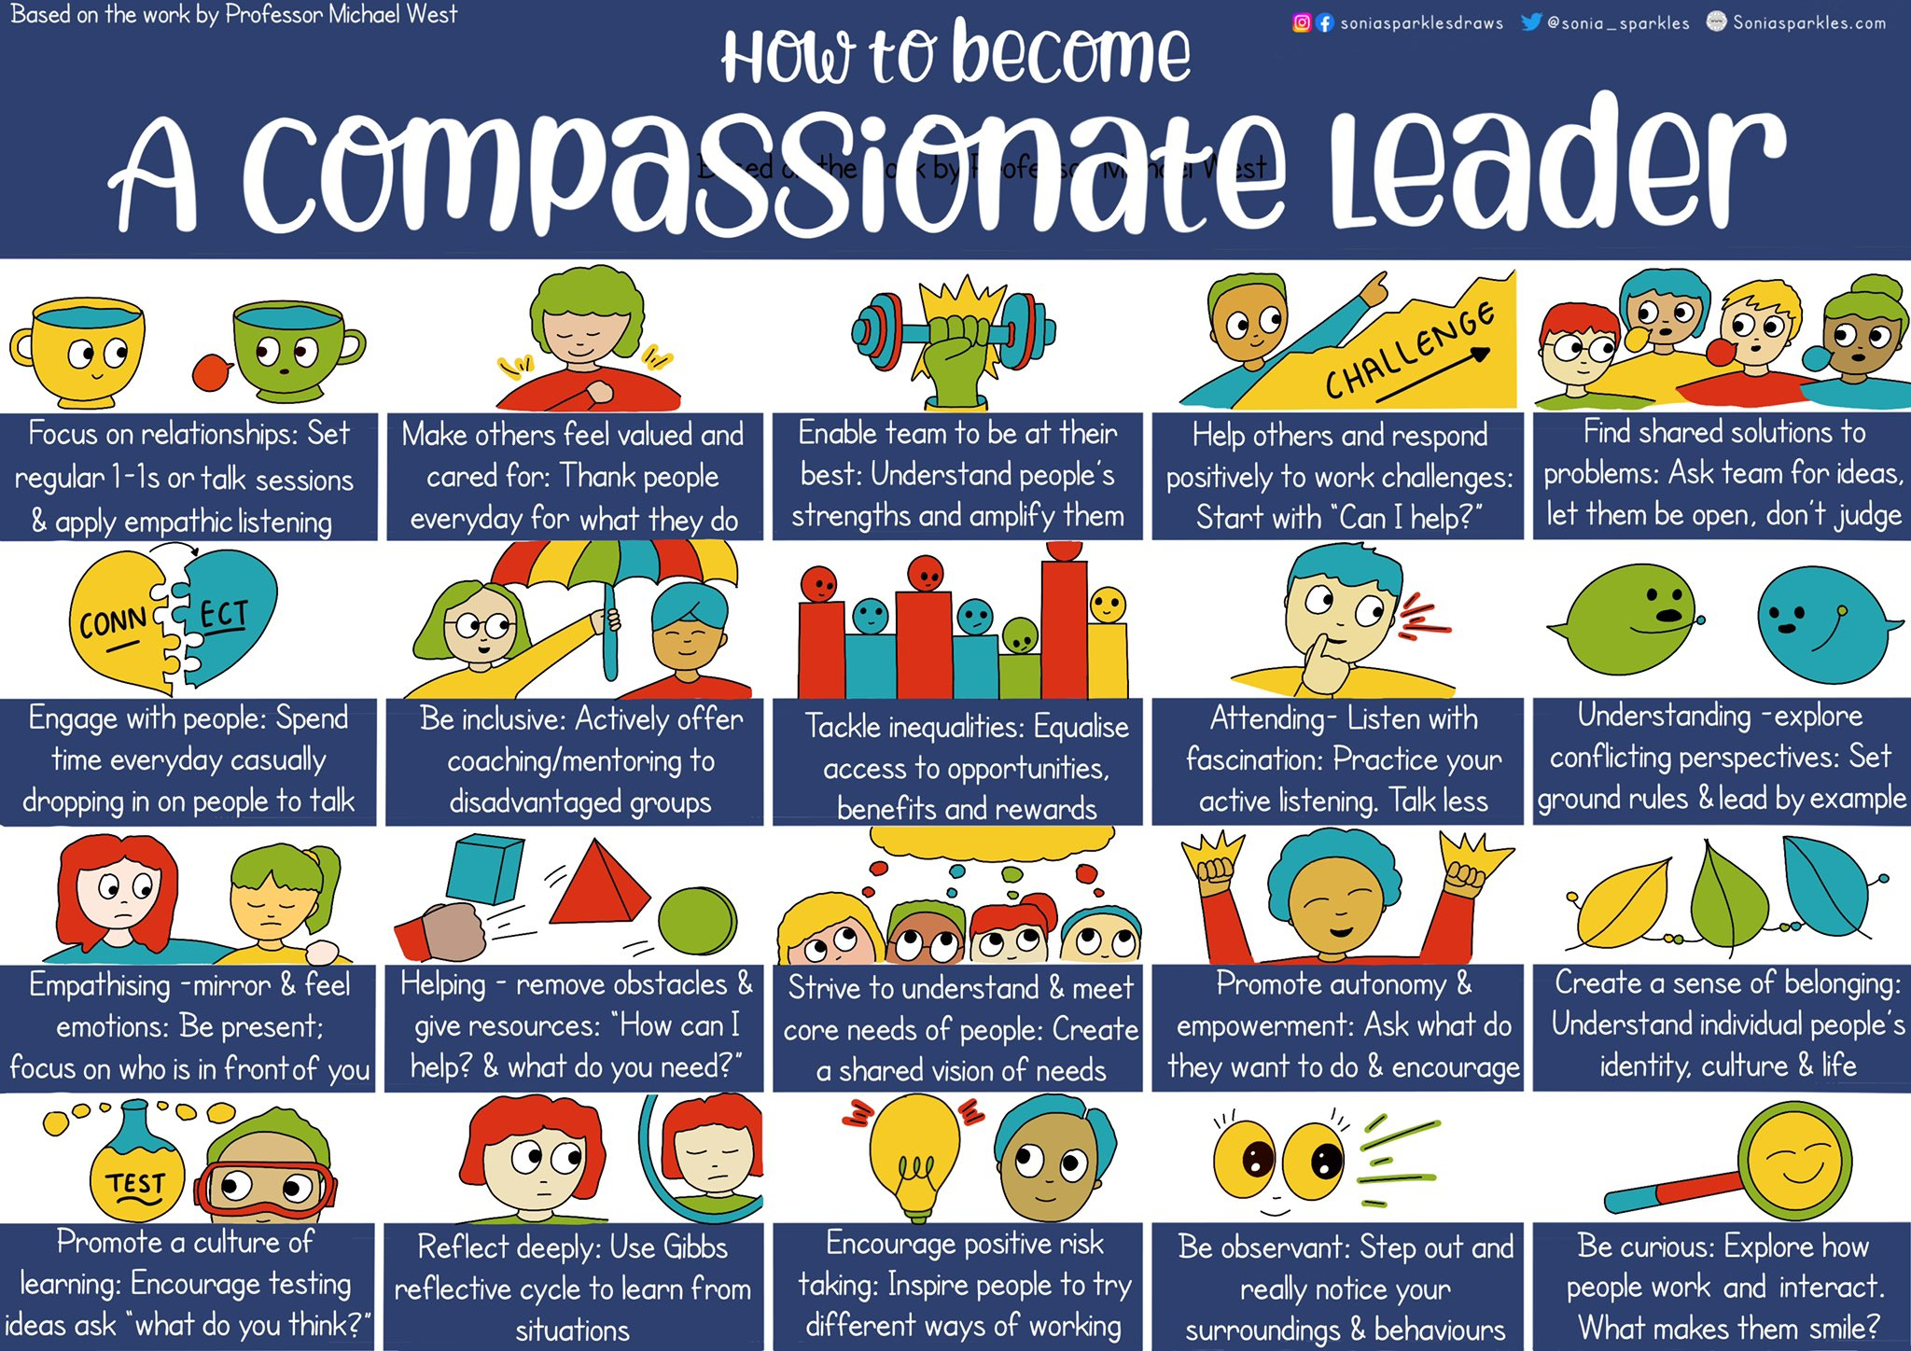
COMPASSIONATE LEADERSHIP

Slide 11
Enabling safe and innovative collaboration through psychological safety
Concepts such as encouraging curiosity and assuming positive intent are behaviours which align with transformational leadership and adaptive leadership, which support the methodology to tackle complex, systemic challenges. ​
​
Practiced consistently, they will enable teams to collaborate effectively and co-create solutions​.
Encourage curiosity
Assume positive intent
Speak plainly
Own your impact
Pause and reflect
Challenge with care & embrace feedback
Adapt and evolve
Psychological safety
Celebrate vulnerability
Be fully present
Be respectful and inclusive
PSYCOLOGICAL SAFETY

Slide 12
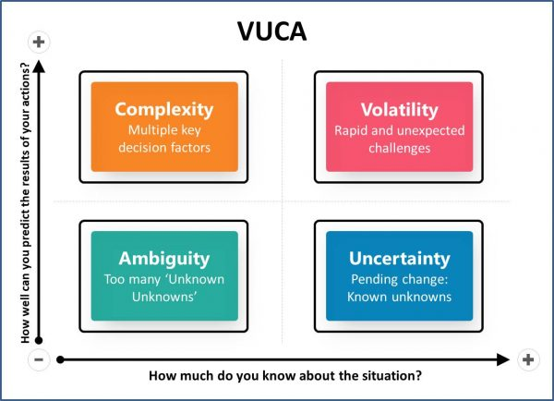
VUCA environments
VUCA EVIRONMENTS
Collaboration happens in a VUCA environment:
• Volatile – unpredictable ED demand & mental health crises
• Uncertain – fluctuating capacity & unclear pathways
• Complex – multiple services, interdependencies, and needs
• Ambiguous – roles, handovers, and priorities can be unclear
Why it matters:
• Linear problem-solving is insufficient
• Requires adaptive leadership & systems thinking
• Psychological safety enables open communication
• Co-creation of solutions = safer, more person-centred care
Collaboration between acute care and mental health services takes place in a VUCA environment – one that is volatile, uncertain, complex, and ambiguous. Emergency Departments face unpredictable demand and time-critical pressures, while mental health services navigate fluctuating capacity, complex patient needs, and variable pathways of care. When these two worlds intersect, the challenges multiply: handovers can be ambiguous, roles unclear, and priorities misaligned.
Recognising the VUCA context is vital because it highlights why traditional, linear approaches to problem-solving are insufficient. Instead, collaboration requires adaptive leadership, psychological safety, and systems thinking to enable teams to respond flexibly, share information openly, and co-create solutions in real time. In this way, acknowledging VUCA isn’t just theoretical – it frames why new ways of working together are essential to deliver safe, timely, and person-centred care.

Slide 13
Change solutions with human factors lens
Step 1: Your challenge
Think about your team focus area.​
What is the core issue we are trying to address?​
Can you write a statement?​
Frame the issue not only in terms of system outcomes, but also human experience and behaviours.
CHANGE SOLUTIONS WITH HUMAN FACTORS LENSE PART 1
Step 2: Map the patient journey/
Barrier identification
Using your driver diagram to identify the secondary issues
For example Communication breakdown, Ambiguity, Process control
Use human factors categories.
i.e. human, cultural, and behavioural contributors, not just processes / resources.

Slide 14
Change solutions with human factors lens
Step 3: Change solutions with a
human factors lens
Using your change solutions from your driver diagram, add any reflection or considerations from a human factors lense. This is to support you to implement them. Use the questions on page 15 to guide your discussion.
Change Solution (from your driver diagram) | Factors to consider from a human factors lens
CHANGE SOLUTIONS WITH HUMAN FACTORS LENSE PART 2

Slide 15
Change solutions with human factors lense
System Interfaces & Coordination
Where do ED and MH processes intersect, overlap, or conflict?
Are there clear escalation points and accountability lines?
Decision-Making & Risk Management
Are critical decisions supported by data & expertise - are decisions delayed, duplicated, or unclear due to system complexity?
How does organisational culture affect decision-making under pressure?
Communication & Information Flow
Are there high-level communication breakdowns between departments or teams?
How does leadership visibility and engagement impact communication effectiveness?
Teamwork & Relational Coordination
Are priorities, goals, roles, responsibilities clearly defined and aligned?
How does the quality of inter-team relationships impact patient care and collaboration?
Capacity, Workload, and System Stress
How do resources, demand surges, or staffing patterns create system vulnerabilities? (constraints or bottlenecks)
How can leadership anticipate and mitigate systemic pressure points?
Psychological Safety & Leadership Influence
Does the system enable staff to raise concerns or suggest improvements safely?
Are leaders actively fostering a culture that supports learning, adaptability, and resilience?
CHANGE SOLUTIONS WITH HUMAN FACTORS LENSE PART 2

Slide 16
Prioritizing ideas to test out
What ideas should you pick to test out first?
Quick Wins
Major projects
Impact
Priority Matrix
Priority Matrix
Effort
Nice to have
Thankless tasks

Slide 17
Just “do it” vs PDSA
Do you really need to do a PDSA cycle or can you “just do it?”
Is it a simple, well understood idea which is straight forward?
Is it something that’s been solved before (root cause is known)
Are you confident the way you want to do it is the best possible approach?
Does it require low effort (e.g., a quick win)
Does it require minimal input from other stakeholders?
Is the risk of it not “helping” low?
Consider a JUST DO IT approach
Just “do it” vs PDSA
Do you have a few possible suggestions for how to do the change idea?
Are you not sure about what the best version could be?
Do you feel like you need to test it and learn in practice before fully embedding it?
Do you need input from other stakeholders?
Do you need to get some feedback from others on how it works in practice?
Does it require some planning and understanding from others?
Consider using a PDSA approach - Wait for learning Session 4 and Action Learning Period 4

Slide 18
Reflective log
Keep track of your progress
What one thing have you learnt since joining the collaborative that you have found most valuable?
What have you discovered that you want to learn more about and develop a better understanding in?
Reflective log
What will you take away and ensure you continue to use when thinking about implementing further changes/improvement?

Slide 19
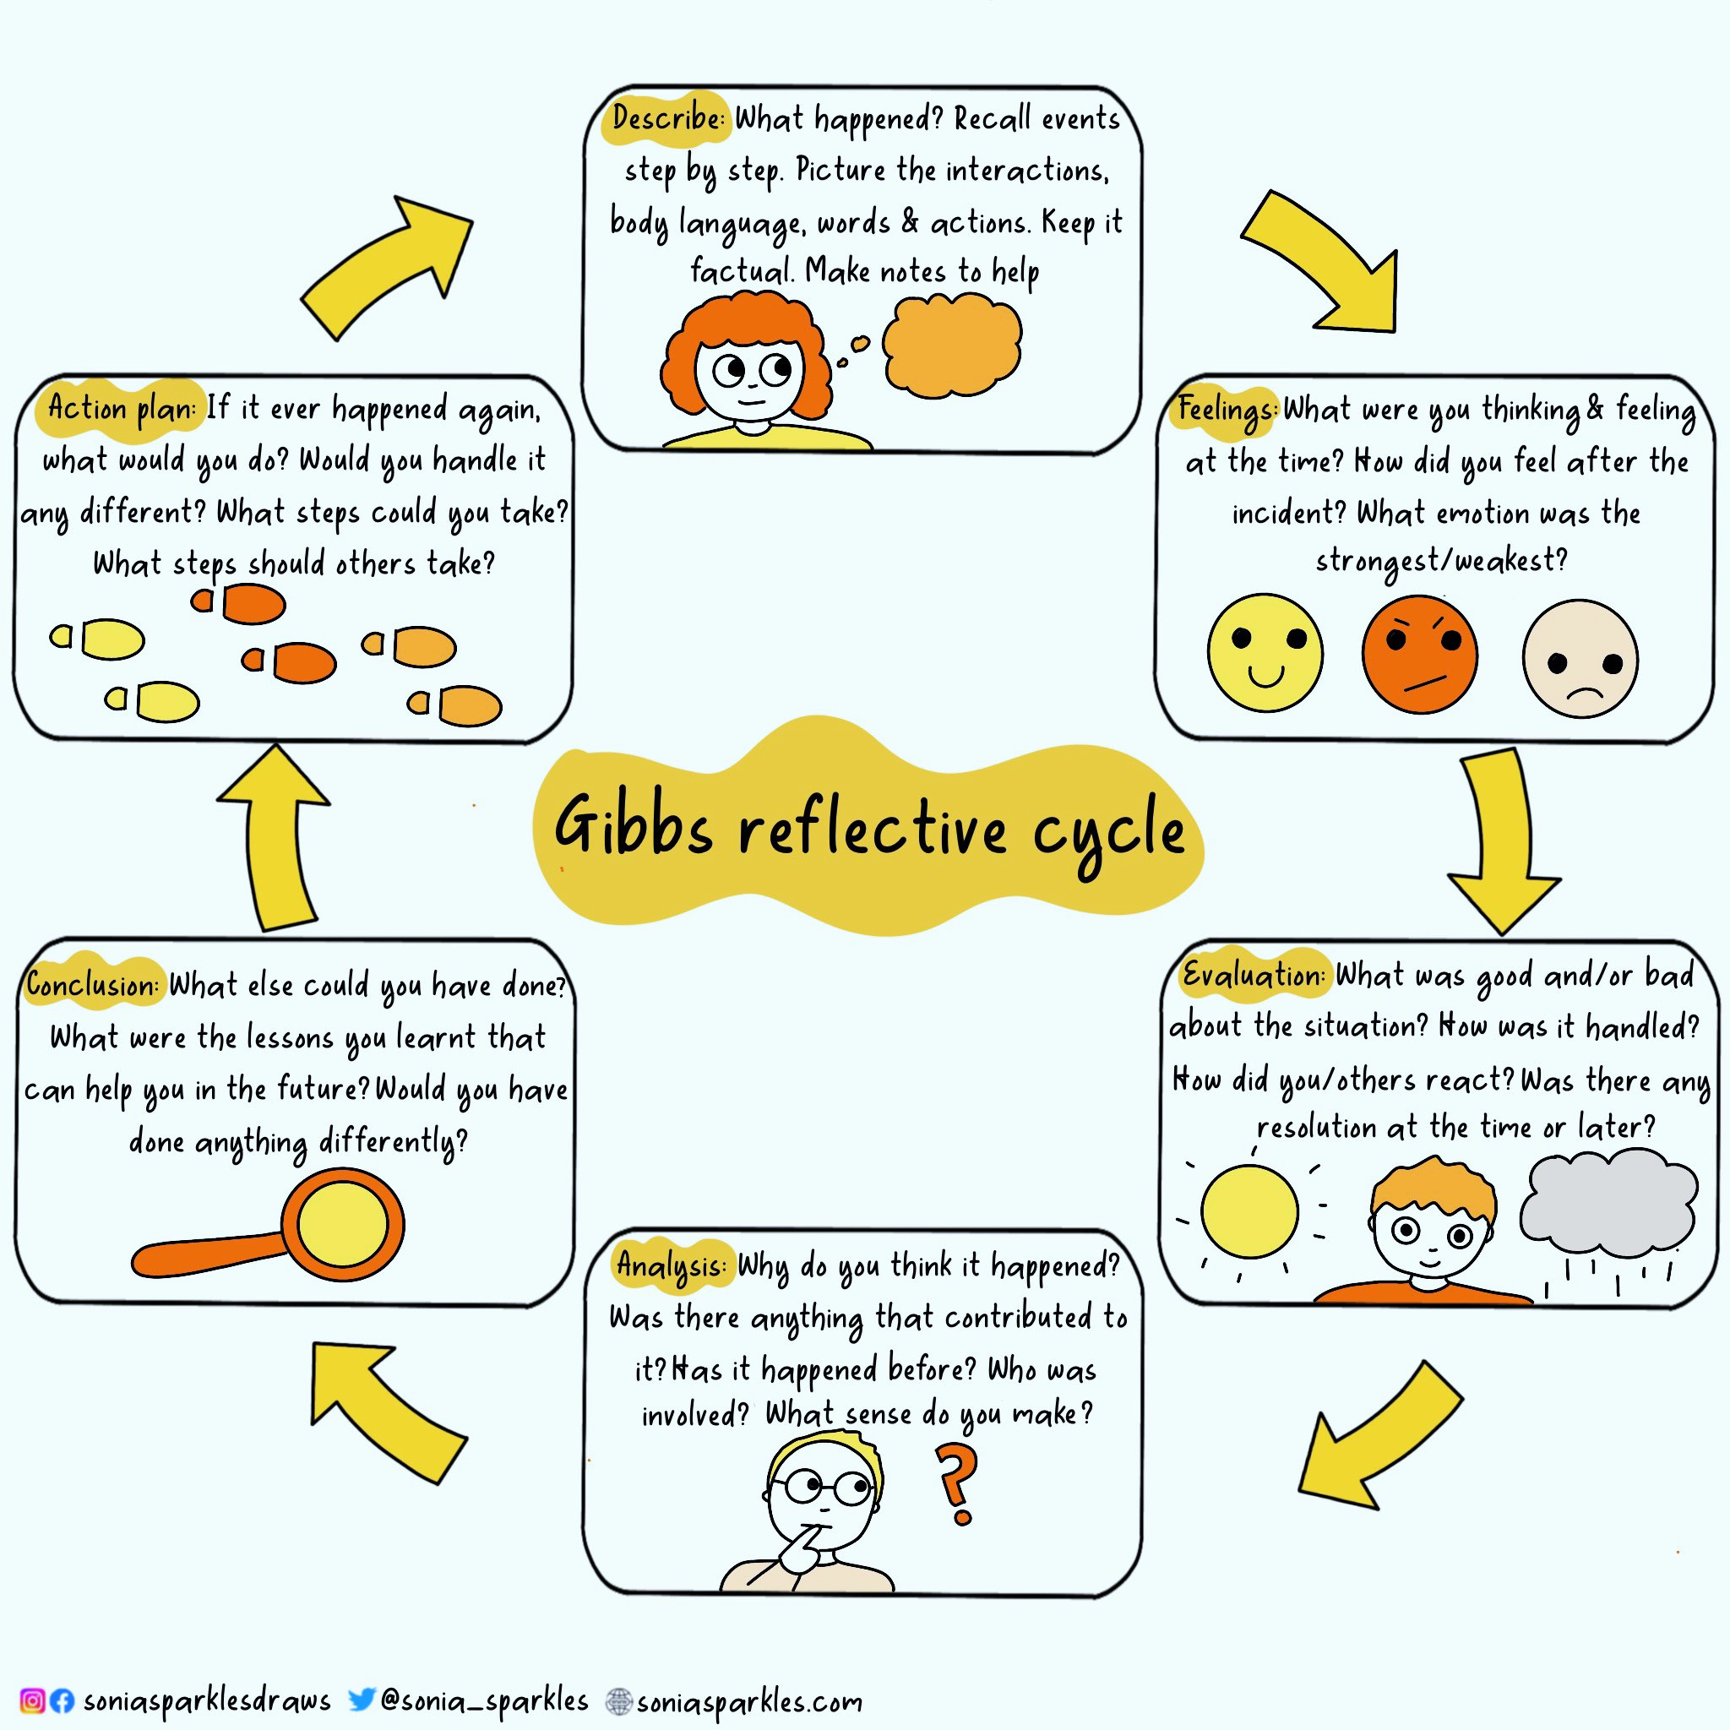
Reflective Learning
How will you reflect on your journey?
GIBBS REFLECTIVE CYCLE
Reflection is often overlooked as we rush to do the next thing in the improvement journey. How will you ensure you reflect on your learning, your actions throughout your improvement project and interaction with others?
Use Gibbs reflective cycle to make notes on significant events
Use it is a framework to think back over what happened and what you might do differently
Use it to understand different perspectives and the full situation

Slide 20
Recommended Reading
Articles
Human Factors for Heath and Social Care. White Paper.
Developing Collective Leadership for Healthcare - The King’s Fund.
Psychological Safety and Learning Behaviour in Work Teams – Prof Amy Edmundson
The Science of Teamwork in Healthcare: Importance to Patient Safety and Outcomes." Annals of Surgery, 2008.
Managing VUCA: The human dynamics of agility. Journal/Publisher TBD (via PMC).
Transformational leadership. 2nd ed. Mahwah, NJ: Lawrence Erlbaum Associates.
The practice of adaptive leadership: Tools and tactics for changing your organization and the world. Boston, MA: Harvard Business Press.
Health Education England and CIEHF - Human Factors and Healthcare Report.pdf
Books
Leading Change by John P. Kotter, Boston: Harvard Business School Press, 1996.
Dare to Lead – Brene Brown
Team of Teams: New Rules of Engagement for a Complex World – General Stanley McChrystal
7 Habits of highly effective people – Stephen R Covey
The Chimp Paradox – Prof Steve Peters
Leading Change – John Kotter
Leading in a culture of change – Michael Fullan
Compassionate Leadership – Michael West
Emotional intelligence – Daniel Goleman
Using patient experience for improvement - Point of Care Foundation
MeasuringPatientExperience.pdf (health.org.uk)
The Patient Experience Book (england.nhs.uk)
The Art of Thinking Clearly by Rolf Dobelli
Nudge by Richard H. Thaler and Cass R. Sunstein
The Social Leadership Handbook by Julian Stodd
The Power of One, The Power of Many by Bibby, Bevan, Carter, Bate and Robert
RECOMMENDED READING

