Slide 1

Interface Improvement Collaborative
Workbook– Session 2: Measurement and scoping out ideas
`
`

Slide 2

Contents
What is a break-through series collaborative? | 3
Benefits of the interface improvement collaborative | 4
Identifying data list | 5
Measurement plan template | 6
Driver diagram template | 7
Brainstorming | 8
Active listening | 9
Observations | 10
Finding best practice | 11
Reflective log | 12
Gibbs reflective cycle | 13
Recommended Reading | 14

Slide 3
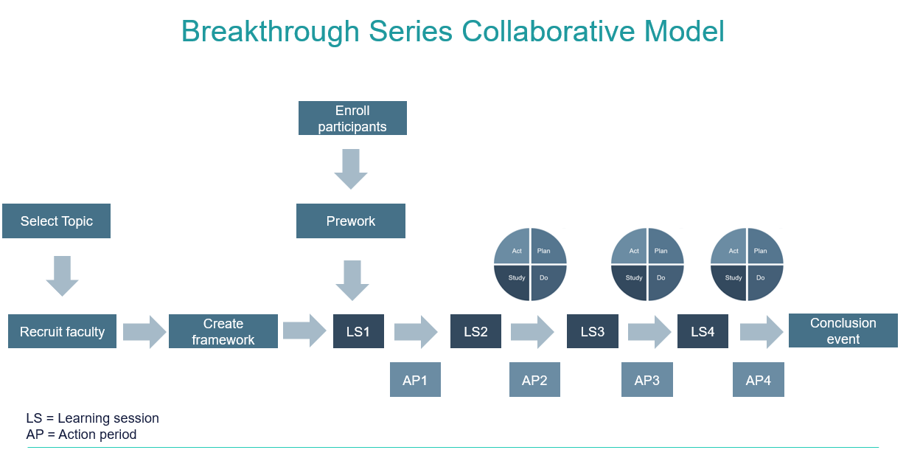
What is a breakthrough series collaborative?
A simple structured way to carry out improvement
Designed for large scale testing across multiple areas
Based on Institute for Healthcare Improvement (IHI)
It usually lasts between 6-15 months
It has a clear start and end point from problem to solution
It provides staff with basic tools and training
It provides a framework to apply learning in practice
There are a series of learning sessions over a period with structured improvement methodology and peering learning in them. In between each learning session, are action periods where participants are expected to apply their learning in practice and share progress at the following learning session

Slide 4
What are the benefits of the interface improvement collaborative?
Benefits to you
Learning improvement methodology and systems thinking
Transferring learning into practice through action periods
Developing links, connections and peer learning with others
Being part of a community tackling similar issues
Working with others to improve services to patients
Benefits to your team
Building relationships with team members across the interface
Working together on a specific problem to create positive change
Understanding the power of communication, teamwork and culture
Sharing learning, creating understanding and strengthening partnerships
Working together to improve services to patients
Benefits to patients
Working together as a team to improve patient experience across the interface
Improving accessibility, communication with patients and continuity of care
Some of your improvements will help reduce time wasted by patients
Their care is provided and completed in the right person by the right profession

Slide 5
Examples of data sources
There is a wealth of data that already exists
Safety incidents | Patient survey results | Clinical audits
Complaints | Staff survey | Patient feedback
Waiting times | Observations | Interviews
Targets | Performance statistics | Create your own tally!
Activity levels | Characteristic factors | Financial
Operational service data | Harm rates | What else?
IDENTIFYING DATA

Slide 6
Measurement Template
Being clear on who will collect what, when and how
Measure Definition What is the data you want to collect – define it | Type of measure Outcome Process Balancing Which one is it? | Concept Why Measure it? | Frequency How often will it be collected? Will it be all occurrences, a sample or snapshot? | Data Collection How will the data be collected? Is there a system? Will it be done manually? | Person Who will be the person responsible for collecting it?
MEASUREMENT TEMPLATE

Slide 7
Driver Diagram
Gathering all your change ideas
Driver Diagram Template

Slide 8
Brain storming
Gathering all your change ideas
Brainstorming is about the generation of lots of new ideas.
Work as a team to think of as many ideas that could help you achieve your aim statement
Write them on post it notes and keep on generating new ideas with the team all doing the same thing
Small or big, wild or sensible- all ideas are welcome, at this stage don’t judge them
The ultimate goal should be 100 ideas in an hour! Go for quantity not quality
Don’t get fixated on trying to work out how it would work in practice – that can come later
Build and jump – bounce around ideas, back & forth, build up, keep the energy levels up
Encourage everyone to join in- it’s not hierarchical
Let’s add to that idea…
Let’s take it up a level…
Brainstorming – Finding ideas for driver diagram
What if we also…
Why don’t we …
And then we can…
You can also include…

Slide 9
HANDOUT
Active Listening
3 LEVELS OF LISTENING
LEVEL ONE
Internal: Focus on your own thoughts and inner voice. You are listening with the intent to respond – not to understand
LEVEL TWO
External: Listening intently to others. You are fully present and focused on them. You are curious about them. This is when people begin to feel seen and heard
LEVEL THREE
Global/wider: Extend focus beyond the conversation to your surroundings as well. You use all senses to feel the complete context
https://medium.com/swlh/strategic-leadership-the-3-levels-of-listening-e3f0c27f8d01
ACTIVE LISTENING – finding ideas for driver diagram
Practice
Have a conversation with someone where you need to do most of the listening. Ask them at the end of it if they’d feel comfortable in providing feedback on their perception of your listening. Choose someone who you know is comfortable in providing honest feedback
Did you feel like I was fully committed to listening to you?
Did I show any behaviors that suggested I wasn’t listening?
How did you feel talking to me? Did you feel heard and seen?
Is there anything I can do better to be fully engaged with you?
Did I show a good understanding on what you were talking about?
Did you notice anything about my facial expression, body language or tone?

Slide 10
HANDOUT
Observations
3 TYPES OF OBSERVATION
SILENT
Useful when collecting raw data and typically takes only a couple of minutes to an hour
INTERACTIVE
Requires the observer to visit the actual place to observe the process, ask questions, and learn
EXTENDED
The observation period takes much longer time to thoroughly understand the current state of a process
https://citoolkit.com/articles/observation/
The 3 basic rules of Gemba walk
Gemba means “the place where value is created” in Japanese. Its initial purpose is to observe the actual work process, engage with others, gain knowledge about the work and explore opportunities for improvement.
Step 1: Go see: You have to go see with your own eyes how the connections and different processes work
Step 2: Ask why: You have to understand each step of the process in detail in order to understand the problems. Many tasks are done routinely without the staff wondering if they are right or wrong. Asking why will help you understand how to improve processes.
Step 3: Show respect: You should show others that you care for their well-being. Make sure to involve them and let them know that gemba walks are taking place. You are not there to judge, share your opinion or criticize.
Write down everything that is of importance or record it with your phone
OBSERVATIONS – finding ideas for driver diagram

Slide 11
HANDOUT
Finding Best Practice
HSJ Award winners/entries | A source to identify best practice that has won awards/recognition for success https://awards.hsj.co.uk/2023-winners
NHS Confederation | Search a range of publications/case studies on best practice https://www.nhsconfed.org/publications
The British Medical Journal (BMJ) | BMJ is a global healthcare knowledge provider with a vision for a healthier world https://www.bmj.com/news/news
The Health Foundation | Work with others to improve people’s health and reduce inequalities https://www.health.org.uk/news-and-comment/news
Nuffield Trust | Independent healthcare think tank https://www.nuffieldtrust.org.uk/news-and-opinion
Kings Fund | Independent charitable organization working to improve health and care in England. https://www.kingsfund.org.uk/publications
Q community | Community of people collaborating to improve the safety and quality of health and care. https://q.health.org.uk
NHS England | Lead the NHS in England to deliver high quality services for all https://www.england.nhs.uk/news/
NHS Fab stuff | A social movement for sharing Health & Social Care Ideas, services and solutions that work https://fabnhsstuff.net/
Futures NHS | A collaboration platform - leading space for secure collaboration across different organisations https://future.nhs.uk/
Academy of Medical Royal Collages | General practice and secondary care report
BEST PRACITCE – finding ideas for driver diagram

Slide 12
Reflective log
Keep track of your progress
What one thing have you learnt since joining the collaborative that you have found most valuable?
What have you discovered that you want to learn more about and develop a better understanding in?
Reflective log
What will you take away and ensure you continue to use when thinking about implementing further changes/improvement?

Slide 13
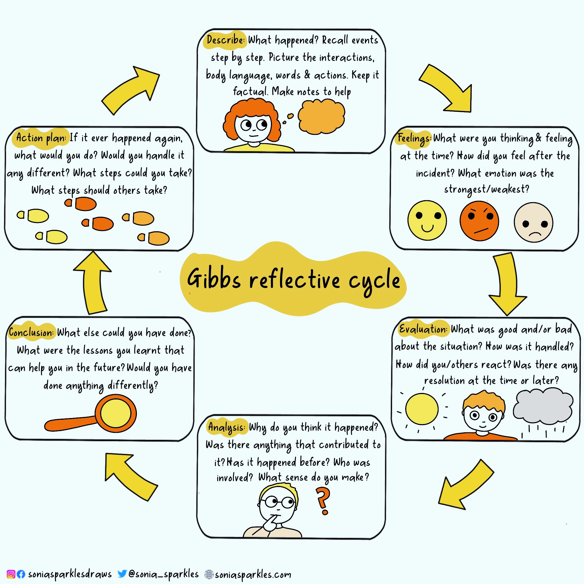
Reflective Learning
How will you reflect on your journey?
GIBBS REFLECTIVE CYCLE
Reflection is often overlooked as we rush to do the next thing in the improvement journey. How will you ensure you reflect on your learning, your actions throughout your improvement project and interaction with others?
Use Gibbs reflective cycle to make notes on significant events
Use it is a framework to think back over what happened and what you might do differently
Use it to understand different perspectives and the full situation

Slide 14
Recommended Reading
Start with Why – Simon Sinek
Dare to Lead – Brene Brown
Team of Teams: New Rules of Engagement for a Complex World – General Stanley McChrystal
7 Habits of highly effective people – Stephen R Covey
The Chimp Paradox – Prof Steve Peters
Leading Change – John Kotter
Leading in a culture of change – Michael Fullan
Compassionate Leadership – Michael West
The improvement guide – Gerald J Langley
Rebel ideas – Matthew Syed
Emotional intelligence – Daniel Goleman
Using patient experience for improvement - Point of Care Foundation
MeasuringPatientExperience.pdf (health.org.uk)
The Patient Experience Book (england.nhs.uk)
Ladder of co-production (https://www.thinklocalactpersonal.org.uk/ )
The Art of Thinking Clearly by Rolf Dobelli
The Decision Book by Mikael Krogerus and Roman Tschappeler
Nudge by Richard H. Thaler and Cass R. Sunstein
The Social Leadership Handbook by Julian Stodd
The Power of One, The Power of Many by Bibby, Bevan, Carter, Bate and Robert
The Exceptional Potential of General Practice Edited by Graham C. M. Watt
The Surprising Power of Liberating Structures by Henri Lipmanowicz and Keith McCandless
Storytelling with Data in Healthcare by Masick and Bouillon
Think Fast, Talk Smart: Communication Techniques from Stanford Graduate School of Business (podcast by Matt Abrahams)
Primary and Secondary Care Interface - NHS Cheshire and Merseyside
The speed of Trust – Stephen Covey
Information is beautiful – David McCandless
RECOMMENDED READING

