Slide 1







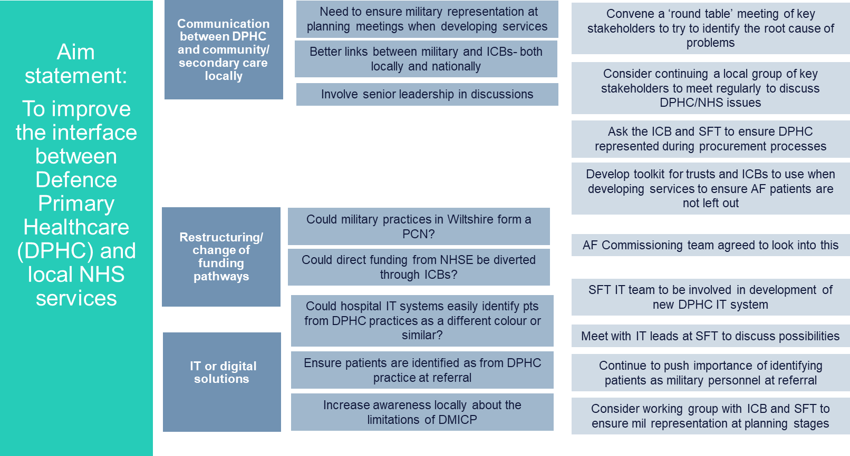





Defence Primary Healthcare: Accessibility of services in secondary care
Wiltshire
Logos here
Background
Driver Diagram
Intended/outcomes
Patients from military practices do not always receive an equitable NHS service as compared with patients from standard NHS practices, in contravention to the Armed Forces Covenant. Key areas include an inability to access certain orthopaedic services (including community physio); mental health services; and intermediate triage services e.g. ophthalmology.
1. Better awareness and understanding of military services/needs across community and secondary care services
2. Increase engagement and participation of armed forces in decision making processes for services
3. Better accessibility for civilian patients to secondary care services that they need
Aim & Stakeholders
General Reflections
Aim: Reduce inaccessibility to community and secondary care services (starting with orthopaedics & physio) for patients of military practices across Salisbury by June 2025
Project team: GP (Defence Primary Healthcare), GP Liaison Manager (SFT), DPHC RHQ Operations' Manager, ICB Armed Forces Single Point of Contact
1. Important to identify, secure and engage key stakeholders early.
2. Face to face talking is much better for relationship building and effective communication.
3. Raising awareness can lead to positive change.
4. Regular project team meetings and purpose should be done early.
PDSA cycles/testing
Currently exploring:
1. Introduce process map into Sailsbury hospital to be used when designing new services (process mapping).
2. Improved inter-communication between armed forces and secondary care service providers through working group.
3. Easier identification of patients from Defence Medical Services in secondary care through IT.
4. Review of procurement processes for services available to civilian patients.
5. Development of a toolkit for use by trusts/ICBs when designing or procuring a new service to ensure AF patients’ needs are considered.
Measurement
Next & sustainability
1. Regular working group to help keep the momentum going.
2. Better engagement with ICB to ensure system level change to procurement.
3. Develop a toolkit for use by trusts and ICBs, locally and possibly nationally.
3. Continue to raise the awareness of this national level problem.
1. Referral rates for civilian patient be ref to physio/ESP
2. Level of military rep in referral pathway design
3. Create & track access to first contact physiotherapists
4. Referral and access rates for orthopaedic services in secondary care
Project developed through the NHS Confederation’s primary and secondary care interface improvement programme.

