Slide 1
Integrated care communications toolkit
Explaining integrated care systems to elected members and officers of councils

Slide 2
About this slide deck
This slide deck forms part of the Integrated Care Communications Toolkit, a practical resource to help NHS Confederation members communicate changes in the health and care system in England.
Integrated care system (ICS) communications leads − or partner organisations’ communications leads − can use these slides when engaging with elected members and officers of councils.
It explains the reasons that have led to the development of ICSs and what the changes will look like on a practical level. It contains animations and diagrams and features a case study, speaker notes and transcripts to support you.
The language has been kept as simple as possible so it can be used with audiences who are not familiar with integrated care or NHS jargon.
Similar versions are available for engagement with patient groups and the general public and non-executive directors.
Please make sure you have read the copyright licence which covers use of the animations within the slide deck.

Slide 3
What's happening in the health service?
The health service is going through one of the biggest and most exciting changes since it was set up in 1948.
It has to change if it is to work for future generations.
The challenges of dealing with the pandemic have made this very clear.
Currently health services, such as GP practices and hospitals, and care services are all run by separate organisations.
This means some people can fall between the cracks.
Let’s look at Steven’s story

Slide 4
Steven's story

Slide 5
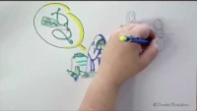
Notes:
Transcript
Steven, age 47, went through a long divorce, ended up with big solicitor bills and debts, then lost his job during the pandemic, couldn’t afford to pay, he developed a drinking problem and depression and it ended with bailiffs repossessing his house and car and he ended up living on the streets.
He had high blood pressure, depression, health conditions due to his drinking problem, all made worse by the fact he is now living on the streets.
Because he moved out of his family home, he didn’t register with a new doctor so has no GP. He has been talked to by a homeless support worker from the voluntary sector, and has been arrested several times for being drunk.
He has ended up in hospital several times, brought in after the public called an ambulance for him. His underlying issues are not being addressed, he is just being treated by different places when his symptoms cause problems.
He has been put into homeless shelters by various charities, but without any support to turn his life around, he is always asked to leave due to his drinking problem leading to aggressive behaviour.
He can’t understand how his life fell apart so quickly and is starting to feel suicidal.
Steven has no co-ordinated care currently. He is either left on his own, admitted to hospital, or arrested.
But it doesn’t have to be like this.
The changes being made to the health service now, are to make all the different organisations work together in a better way. This is already happening in some places but will become law in July 2022.
Let’s look at a different approach.

Slide 6
Case study: Mid and South Essex Health and Care Partnership
The Southend Integrated Healthcare for Homeless initiative has been spearheaded by local GP surgeries and other local organisations, to provide better joined-up care for those affected by homelessness in Southend.
Partners from the NHS, Southend-on-Sea Borough Council, food banks, soup kitchens, hostels, outreach teams, hospital, mental health and substance misuse providers have collaborated to build this new integrated service.
The initiative has already seen positive outcomes by maximising opportunities to deliver preventative health initiatives, such as Hepatitis C, respiratory, blood pressure and COVID-19 testing.
Word of mouth from clients has consequently attracted others who were unsure or previously hesitant in accessing healthcare services.
This has helped to reduce avoidable use of crisis services while ultimately reducing premature deaths.

Slide 7
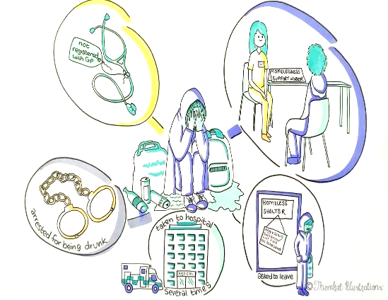
Working together for people
In the future people like Steven, who have a lot of different needs, should receive a much more joined-up service for both health and care needs.
This new way of working, called integrated care, is going to be carried out across England through 42 new organisations called integrated care systems.
It's all about working better for people's health and brings councils and the health service together.

Slide 8
How will health and care work together?
The biggest change that this new way of working will bring is that the NHS and local councils – which deliver many care services – will be working together as part of a new organization.
When the NHS was set up in the 1940s its aim was to treat symptoms. But it has come a long way since then, supporting people to live healthier lives. This change is continuing along that journey and aims to bring social care and health even more aligned.
Our health is affected by many things – housing, unemployment, financial stress, domestic abuse, poverty and lifestyle choices. This is something that we need to look at through a partnership between the NHS, local government and the voluntary sector.
Let's look at the effect that can have – here’s Gill's story.

Slide 9
Gill's story

Slide 10
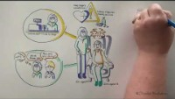
Notes:
Transcript
Gill is 65 and works part-time in a shop and cares for her 78-year-old husband John, who has dementia. She has a heart condition herself and needs to take regular medication.
Gill has told her GP she is caring for her husband but she downplayed the problems as she is worried he will get taken into a home if she does. She pays a cleaner to come and help with the house but she does all the personal caring herself.
John is becoming increasingly agitated and lashes out at her while she tries to help him. He also forgets whether or not he has eaten, and accuses her of trying to harm him.
John often wanders off down to the shops or into the town and then has to be brought back by friends, or is picked up by the police. They live in a two-storey house and he has had several falls down the stairs and ended up in a and e.
Gill has tried speaking to a private care company for help but is waiting for them to get back to her and is worried it will be too expensive. She hasn't been looking after herself and is suffering from anxiety.
Gill and John have a number of issues which need addressing, from unsuitable housing, to support with cleaning and care, to help with nutrition.
None of these are issues which fall under the NHS, but they are all affecting this couple's health.
In fact, many of their problems would be better dealt with by their local council. Local councils have a long history of working to improve population health.

Slide 11
What role do councils play in healthy populations?

Slide 12

Council duties
All upper tier councils have considerable statutory duties relating to health.
District councils have responsibilities for areas such as housing and employment, which impact on health.
Notes:
Upper tier councils such as County Councils, have always held considerable statutory duties related to health, for example:
Public health – keeping the public healthy and well – sits within councils
Health and wellbeing boards and Health Overview and Scrutiny Committees have always been run by local councils
The duty to produce joint strategic needs assessments
The duty to produce joint health and wellbeing strategies
The duty to promote integration and address health inequalities
While district councils have always had responsibilities for health in terms of providing good housing, leisure and recreational facilities which all contribute to health.

Slide 13

Who leads on health in councils?
There are many key roles in councils that lead on health priorities and these will be vital as the new ICS structures are embedded.
Notes:
Leader/ elected mayor – key role as a place leader to promote better health and wellbeing of their communities. Likely to have a key leadership role in the ICS and ICP
Cabinet member for social care/public health/health and wellbeing/people – key partnership role in working with ICS and ICB on commissioning adult social care services and driving integration.
Health and Wellbeing Board Chair and members – leaders of existing place-based forums and key in working with ICS place-based partnerships.
Health overview and scrutiny chair and member – key role in local accountability of NHS services, including ICS. An important partner in developing ICS plans and in proposed service reconfigurations.
Representatives on regional and national bodies – combined authorities, strategic partnerships etc.
Ward councillors – all councillors are first and foremost ward councillors with a strong link to their ward constituents.

Slide 14
How can local councils help?
Many councils have embedded health improvement into all their policies and strategies, including housing, early years, growth, skills and employment. Health reaches into every aspect of life after all.
Local councils also have lots of information about their area, such as levels of poverty and housing problems, which they will now be sharing with health services.
Local councils also run social care services, so they can now make sure those are linked up with health. This means that if someone is leaving hospital, they can make sure there is care available when they get home.

Slide 15

Building on good ideas
It’s important to note that in many areas excellent partnership working is already happening at place level, and has been for many years.
Many councils have very well-established partnerships with health services.
For example, every location already has established health and wellbeing boards and health overview and scrutiny committees
These boards and committees, run by councils, will continue to exist within the new ICS structure and work jointly within the new approach.

Slide 16
Linking councils and NHS together − officially
Notes:
The aim of this new integrated way of working is to build on all the good ideas and great ways of working that already exist, and make sure they are being used across the country.
The new way of working won’t end any existing positive partnerships between health services and councils, it will help them to grow.
But what will that look like?

Slide 17
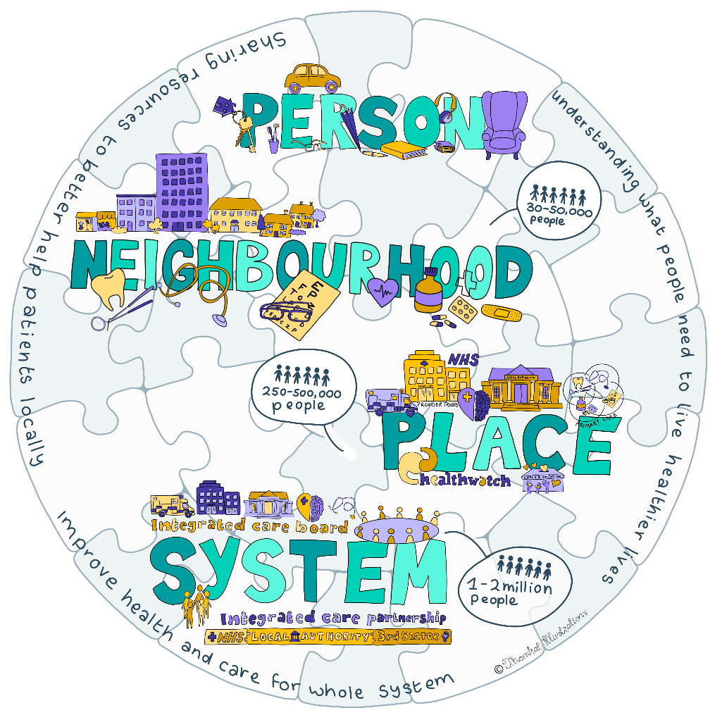
The new ICS structure

Slide 18
The new integrated health and care service
Neighbourhood level
Place level
System level
This is the first and smallest level of the new system, which covers around 30,000 to 50,000 people.
This is where most of the service changes will happen and covers around 250,000 to 500,000 people.
This is the largest level and is where the budget is held and decisions will be made. It covers around 1 million to 3 million people.

Slide 19
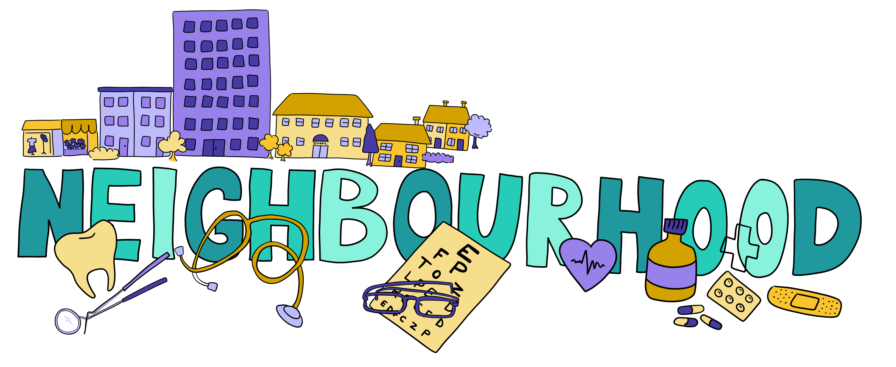
Neighbourhood level
At neighbourhood level, this is where GPs, opticians, dentists and community pharmacies will work together to deliver primary care. That’s care outside of a hospital.
They will all work together in a small local area, to form a primary care network. All doctors and primary care professionals will be part of one of these networks now. It means they can share resources to better help patients locally.

Slide 20
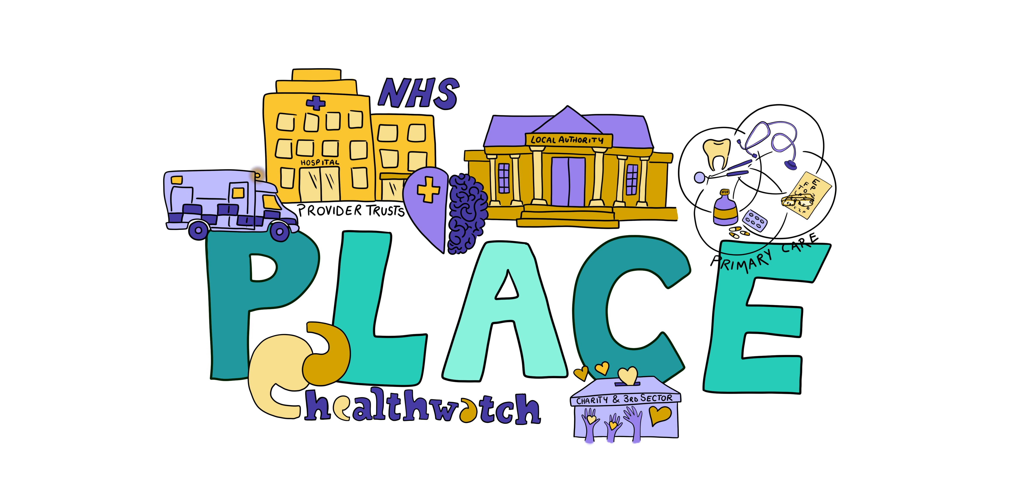
Place level
This is a wider area and a place will include several neighbourhoods. This is where most health and care services will be delivered including hospital care.
There will be place-based partnerships, where local hospitals, care providers, local councils, doctors and the voluntary sector can come together to discuss key health and care issues in their place.
If there are existing partnerships, these will continue, and new ones will be developed if needed.
Notes:
Most councils already have a health and wellbeing board and these will continue to work, within the place level, providing vital information.
Organisations which provide health services, such as hospital trusts, are known as providers. They will work together with other providers within their place area, to share resources and information to better support patients. These are known as provider collaboratives.
One of the key benefits of health and care services all working together at a place level, is all of those organisations will have good knowledge of the health problems in the area.
Local councils will be able to share their information about population health, public health issues, and all the other demographic information which has an impact on people’s health and care.
One of the roles of the place-based partnerships will be to look at what the people living in their area need, to help live more healthy lives, and they will pass this information up the ladder to the Integrated Care Partnership.

Slide 21
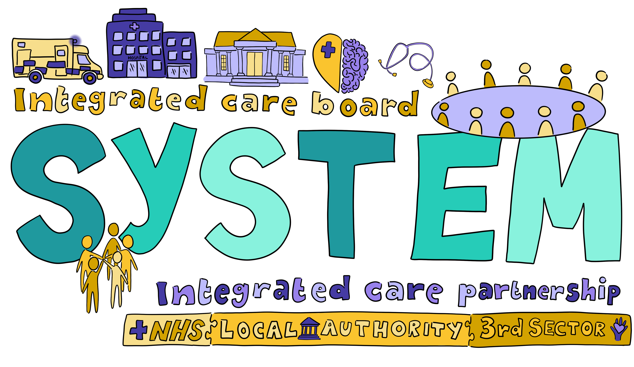
System level
The integrated care system, which is responsible for running all the services, is made up of two key bodies:
Integrated care partnership
Links in with all the wider partners −including the voluntary sector, employment, health − at place level. Through discussion with those partners, uses the information about the local population to create a strategy for helping everyone who lives in the system area to live healthily.
Integrated care board
Is in charge of the NHS money and making sure the services are in place to make the strategy become a reality on the ground.
Notes:
The integrated care partnership
This is a committee made up of representatives from all the different health and care organisations across the wider system area. They will meet together to discuss the big issues affecting the health of people and come up with ways to improve health and care in their area.
The integrated care board
This is an organisation made up of representatives from the NHS and the local council and they will be responsible for the budget and making decisions about health services in their system area. They have to make sure the services match the ideas put forward by the partnership.

Slide 22
Rewriting Steven’s story
How integrated care makes a difference

Slide 23
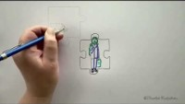
Notes:
Transcript
Steven age 47, went through a long divorce, ended up with big solicitor bills and debts, then lost his job during the pandemic, couldn’t afford to pay, he developed a drinking problem and depression and it ended with bailiffs repossessing his house and car and he ended up living on the streets.
He had high blood pressure, depression, health conditions due to his drinking problem, all made worse by the fact he is now living on the streets.
A homelessness care worker is alerted to Steven after he is taken to hospital by ambulance. The care worker works jointly with the other agencies at place level to set up a plan for Steven.
Steven now has a contact he can call if he gets into problems. The care worker liaises with housing to get Steven into better accommodation. He works to get him the right financial benefits in place and makes sure he is registered with a local GP.
The GP works to get Steven’s blood pressure, depression and health issues under control and refers him to a local voluntary group which supports alcoholics.
Steven is supported to get back on his feet by a team that work together to ensure he gets all the care he needs.

Slide 24
Rewriting Gill’s story
How integrated care makes a difference

Slide 25
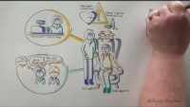
Notes:
Transcript
Gill is 65 and works part-time in a shop and cares for her 78-year-old husband John, who has dementia. She has a heart condition herself and needs to take regular medication.
Gill has told her GP she is caring for her husband but she downplayed the problems as she is worried he will get taken into a home if she does. She pays a cleaner to come and help with the house but she does all the personal caring herself.
John is becoming increasingly agitated and lashes out at her while she tries to help him. He also forgets whether or not he has eaten, and accuses her of trying to harm him.
The GP is part of a wider Primary Care Network, which includes a Care Officer, working as part of adult social care and linked into the place-based health system. He raises Gill's case with the Care Officer as he has concerns and she seemed anxious.
The Care Officer visits Gill and can see immediately that she needs some home support as well as some adaptations to make the environment safer for John. She explains to Gill all the support that is available and that she doesn't need to continue paying privately for expensive help.
The Care Officer makes all the calls and referrals into all the necessary health, care and support services, to take the pressure off Gill, and follows up with everything to make sure it happens. They also make sure Gill is seen by her GP for her own needs, to get her health back on track.

Slide 26
Thank you

