Slide 1
Volunteering in the NHS
Emma Easton, Head of Voluntary Partnerships
November 2021

Slide 2
Volunteering in The Long Term Plan and People Plan
Greater access for younger volunteers e.g. #iwill, NHS Cadets, Health Challenge Award
Programmes in deprived areas
Inclusive volunteering opportunities
Scale volunteering programmes across the country
Greater recognition of role of volunteering in supporting staff
Double the number of NHS volunteers over the next three years.​

Slide 3
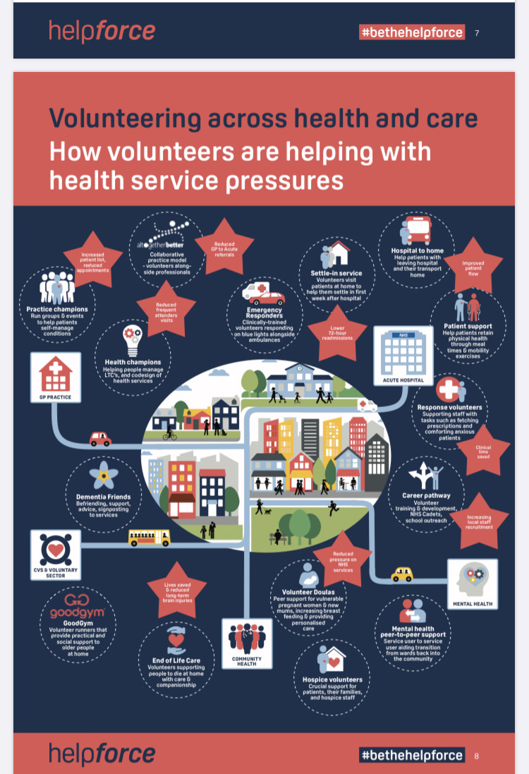
Status of volunteering – pre-Covid
“Health & Care” overall: Est. 3m volunteers (Kings Fund, 2013)
Acute & Community Trusts: Est. 90,000 volunteers (NHSE survey, 2019)
Ambulance Trusts: Approx. 10,000 volunteers
Primary care:
Kings Fund report
www.alltogetherbetter.org.uk – 130 GP practices – 30% fall in frequent attenders
Massive variation in:
Volunteer nos. per trust – acutes generally > community & mental health
Volunteer Service Managers and resource
Types of volunteer roles – over 300

Slide 4
Volunteering and voluntary sector support during Covid
NHS Volunteer Responders
Flexible task-based volunteering in the community
Support for those self-isolating/shielding, NHS/social care services and for staff within health and care sector
Currently delivered by Royal Voluntary Service using the GoodSam app to manage and deploy volunteers
Tasks include:
Check in and chat
Patient transport
NHS transport (moving supplies)
Food/medication delivery
Evolution to support emerging needs e.g. delivery of Pulse Oximeters, supporting clinical trials etc.
Volunteer stewards for the covid vaccination programme
Volunteers within NHS organisations
Voluntary Sector Support
NHS Volunteer Responders
NHS Volunteers
Formalised longer-term volunteering within NHS settings e.g. hospital or ambulance trusts
Supporting NHS staff and patients within settings and during transfers of care
Provides additional capacity
Delivered by local in-house NHS volunteer services
Includes:
Volunteers on wards
Flexible response roles
Pre/post discharge support
Patient liaison roles
Digital/virtual roles
Community First Response
Central NHS EI funding rounds for volunteer projects focussing on:
Recovery of volunteering services
Restoration of NHS services
Reducing pressures arising from Covid/Winter
Supporting staff wellbeing and safety
Improving patient experience and safety
Voluntary Sector Support
Locally, thousands of organisations that provided additional support or ‘pivoted’ their operations
Centrally commissioned support also provided for trusts to relieve pressure in the most challenged areas of the system e.g. weekend discharge, admission avoidance, corridor care and reducing long length of stay.
Currently provided by Age UK, British Red Cross, St John Ambulance and Royal Voluntary Service.
Includes:
National Ambulance Coordination support
Added Emergency Department capacity
Patient Transport
“Home from Hospital” assisted discharge and community wrap around services
Vaccination volunteers

Slide 5
Summary Volunteer and Voluntary sector support during Covid
Priority Areas | Volunteering within the NHS | Voluntary Sector Support | NHS Volunteer Responders
Restoration of NHS Services | Contacting patients for clinics; easing anxiety over attending NHS environment; meet and greet including PPE compliance; support running of outpatient clinics | Mobile covid testing to support stand up of elective procedures; community support to make arrangements for elective procedures | Support for people self isolating pre elective procedures; delivery of monitoring equipment; patient transport for elective/outpatient appointments; transporting of NHS supplies to facilitate temporary clinics
Enhancing A+E capacity and improving flow | Restocking; supporting transfers; managing waiting rooms and liaising with families; escorting patients; running samples | Support for ambulance handovers; clinical support in A+E (Saint John volunteers) | Admission avoidance; reducing readmissions
Flu/Covid vaccination programme | Supporting with local flu campaigns; admin support for vaccination sites | Vaccinators; clinical volunteers; mobile vaccination centres for outreach | Supporting flow in vaccination centres; admin support for vaccinations centres
Improving patient experience and safety | Supporting patients at EOL; on ward activities/company; visitor booking; support with mobility and nutrition; supporting patient-relative communication; transport belongings between patients-relatives; repatriation of belongings | Supporting hospital discharge; personalised wrap around support in community | Individual patient transport; support in community
Supporting Staff Wellbeing and safety | Delivery of staff wellbeing hubs; delivering food and drinks for staff; supporting staff to take breaks; support donning and doffing PPE; added capacity for staff | Added capacity for staff; supporting staff in A+E | Staff transport in inclement weather; food and medication deliveries for staff to reduce transmission risk;
Discharge support and Patient Transport | Supporting patients on admittance to prepare for future discharge; Preparing patients to go home; assist with discharge arrangements; support discharge lounges; transport and settle in services; delivering medication “to take out” (TTO) | Patient transport for patients on pathway 0; Transport of patients with complex needs; community wrap around support and link to other services | Patient transport for pathway 0; support in community with medication/food delivery and check in calls
Mental Health and Community Health Services | Supporting patients to access virtual services, digital support for online therapy; adding capacity and supporting patients in mental health and community trust settings | Community wrap around services; health prevention | Check in and chat calls for isolated people; identifying safeguarding concerns in community
National Ambulance Response | Restocking ambulances; supporting ambulance handovers, Community First Response volunteers enhancing capacity within paramedic teams | Transport of lower acuity patients; emergency response; enhanced capacity through NACC | In development

Slide 6
NHS Volunteer Responders
Est. March 2020 as a ‘back up’: provide additional volunteer capacity to support the NHS and people who were clinically vulnerable.
Over 400,000 active volunteers
Initially - essential tasks such as shopping, fetching prescriptions, welfare calls, equipment and patient transport.
Evolution – Support for people self isolating or in quarantine; vaccination programme, delivery of equipment, clinical trials etc. Single point of contact for NHS Test & Trace.
> 2.1m tasks completed, usage highest in areas of deprivation
Volunteers were the eyes and ears on the ground – identification of wellbeing issues, people who needed care, medical issues, food poverty etc.
What’s next?
Greater integration with local systems
New / adapted roles to meet emerging needs in the NHS e.g. falls response, winter volunteering etc.

Slide 7
Volunteers supporting hospitals during Covid
Huge number of volunteers over 70 or with underlying health conditions
Some roles not appropriate to continue, others were essential – new focus on what else volunteers might be able to do
Significant increase in youth volunteering – e.g. 75% volunteer shifts in West Herts covered by young people
Ambulance service – Community First Responders and Emergency Responders asked to provide greater support
Increased support from voluntary sector partners:
St John Ambulance – Support in hospitals (67,345 hours), additional ambulance provision (43,768 hours), community response (22,708 hours), identifying staff for Nightingale hospitals
British Red Cross, Age UK, Royal Voluntary Service – Home from hospital and community wrap around services
Re:Act volunteers supporting hospitals in new ways e.g. mortuary support
NHS E/I Support
Covid Roles
NHS E/I developed specific covid-contextualised volunteer role descriptions to optimise NHS in-hospital volunteering services. Roles were endorsed and agreed by Clinical Leadership, Infection Prevention and Control leads and PPE supply chain colleagues and are in keeping with national NHS guidance.
Administrative Volunteer
Staff Wellbeing Volunteer
Patient Liaison Support Volunteer
Patient Buddy
Response Volunteer
Meet and Greet Volunteer
End of Life Volunteer
Discharge Support Volunteer
Recovery framework to support organisations to bring back volunteers
Funding for NHS volunteering services
NHS Futures platform to share learning
National Covid volunteering guidance and ongoing support
Building into contingency planning for future – seasonal pressures, significant adverse events etc. – Increased partnership with VCS

Slide 8
Examples of volunteer roles within NHS Trusts
Roles | How they support | Examples
End of Life (EOL) | Supporting patients and family/carers at EOL; supporting communication between family/carers and EOL patients; additional support for staff on wards; | Princess Alexandra Hospital NHS Trust: supporting messages to loved ones and maintain a family hub for bereaved relatives
Discharge | Support discharge lounges; help patients prepare for discharge; assist with discharge arrangements; follow up calls post discharge | Kingston Hospital NHSFT: Volunteer Discharge Support Service
Response | Collecting TTOs; running samples and notes; restocking PPE; moving patient property; escorting patients | West Hertfordshire Hospitals NHS Trust: responsive model for all volunteering supporting patients and staff where needed
Patient Liaison | Supporting communication with families; triaging queries; arranging visiting; delivering patients belongings; | Milton Keynes University Hospital NHSFT: relaying messages and supporting wards to manage visitors
Patient Buddy (On ward) | Support with mealtimes, befriending/patient support; support with mobility/activities on ward, arranging visiting; restocking equipment and supplies; supporting patient discharge from ward | Salisbury NHSFT: assisting with mealtimes on ow risk wards or wards
Digital /Virtual roles | Restoration of services through digital means e.g. Mental Health services; befriending/peer support | South London and Maudsley NHS Trust: delivering phones/IT equipment and supporting patients to access therapy virtually
Staff wellbeing | Delivery of staff wellbeing hubs; delivering food and drinks for staff; supporting staff to take breaks; support with donning and offing PPE | Manchester University NHSFT: packing wellbeing bags for staff, running staff wellbeing hubs, distributing public donations
Wayfinding / Meet and Greet | Greeting and signposting patients/relatives; advice on visiting guidance and use of PPE; restocking PPE and hand gel; temperature checking | Birmingham Women’s and Children’s NHSFT: screening, signposting and escorting patients
Admin | Supporting correspondence with patients; dissemination of patient packs; information; supporting collation of info for SitRep reporting | Royal National Orthopaedic Hospital NHS Trust: volunteers supporting admin teams
Patient Transport | Supporting transport to/from elective/outpatient appointments; discharge home from hospital for patients on pathway 0; Community First Responders | London Ambulance Service: Community First Responders adding capacity to paramedic crews

Slide 9
The Potential
Patients, carers, family
Enhance patient experience
Support families and carers
Connect patients and loved ones
Improved outcomes for patients
Staff
Reduced pressure
Knowing that patients have additional support
Improved experience
Supporting staff themselves
Volunteer
Better health and wellbeing
Giving something back
Increased knowledge, skills, confidence
Route into employment
Services
Reduced pressure
Impact on productivity
Length of stay, discharge, speed of being attended to, patient flow, reduced need for clinical staff
Thousands of people who want to volunteer
Really strong partnerships with voluntary sector organisations
But….. significant variation in volunteering infrastructure

Slide 10
Impact of Volunteering
Volunteers can significantly improve patient experience, contribute to better outcomes for patients and save staff time to focus on clinical tasks. Volunteering also opens pathways to careers in the NHS
Response Volunteers: In an 11-month period 4,888 TTO deliveries made by volunteers, saving 525.46 hrs or 22 days of clinical staff time (West Suffolk)
COVID: “I am immensely proud of the work our volunteers do…..they have played a key role in response to the coronavirus pandemic.” (London Ambulance Service)
Admin: DNA rates dropped from 32% to 16.5% when response volunteers reminded patients of appointments
(Chelsea and Westminster)
COVID: “It has been a really busy start to what I hope will be a long career in the NHS … It is great that I can take a bit of pressure off the NHS and do something for the community.” (Volunteer, Royal Shrewsbury Hospital)
COVID: “We’re so grateful for the wonderful volunteers, it’s the little things they do that helps share the load” (Staff member, Northampton General Hospital)
Discharge Support – volunteers cited as “the single biggest influence on discharge”, playing a critical part of the trust’s efforts to change patient attitudes and behaviour (Kingston)
Nutrition and Hydration Support - One study found meal time volunteers released potential costs of clinical time of £27.04/patient/day of healthcare assistant time or £45.04 of newly qualified nurse time
Settle–in Volunteers - The RVS estimated if home from hospital services could eliminate inappropriate readmissions and were targeted appropriately with full coverage across England, they could reduce readmission costs by around £40.4m per year.

Slide 11
Volunteering and Workforce
HCA Apprenticeships
During Covid, 4 volunteers progressed onto HCA Pathway Apprenticeships at Chelsea and Westminster NHSFT including 2 members from British Airways who had recently lost their jobs in the pandemic.
Volunteers have a played a vital role not only in supporting patients but also NHS staff during the pandemic.
In the short term NHS England is supporting the NHS to focus volunteering efforts on areas that reduce pressure including volunteers supporting the health, wellbeing and safety of NHS staff as they contend with covid and winter pressures
In line with ambitions laid out in the NHS People plan, there is a renewed focus on the “Volunteer to Career” pathway recognising the invaluable experience volunteering offers as a stepping stone into a career in the NHS
At a local level health and care systems, in particular, can build on the role of NHS organisations and large social care employers as anchor institutions, to bring those furthest from employment into meaningful employment and to target recruitment, volunteering and apprenticeship opportunities in areas of greater deprivation.
At a national level NHS England is supporting development of Volunteer to Career programmes and has launched the NHS Cadets programme as a significant start on this journey.
Work Ready Volunteer Programmes
20 volunteers taking part in Northampton General Hospital NHS Trust’s “Work Ready Volunteer Programme” on track to apply for paid HCA roles having gained vital experience and skills throughout covid.
NHS Cadets
Developed in partnership with St John Ambulance, the programme offers a route into volunteering or a career in the health service.
The £6m partnership is focusing on reaching 10,000 young people (age 14-18) from communities under-represented in the NHS workforce.
The programme will equip them with valuable skills such as first aid and mental health first aid, communication, resilience and leadership skills.
Young people aged 14- 16 will undertake the ‘foundation pathway’ which includes volunteering at a local NHS trust.
Young people aged 16-18 will undertake the ‘advanced pathway with a BTEC in leadership and practical first aid volunteer placements.
12 operational Cadets sites with further waiting list of 43. Sites will be onboarded every 6 months with 170 sites by December 2023.
The programme includes mentorship opportunities with The Princes Trust to support young people into NHS employment

